Slide 1
MS&E 228: Heterogeneous Treatment Effects
Vasilis Syrgkanis
MS&E, Stanford

Slide 2
Causal Inference with Experiments
Prediction with Linear Models
Prediction with High-Dim Linear Models
Inference on Causal and Predictive Effects with High-Dim Linear Models
Potential Outcomes and Conditional Ignorability
Structural Equation Models and Conditional Exogeneity
Directed Acyclic Graphs
Prediction with Non-Linear Models
Inference on Causal Effects with Non-Linear Models
Un-observed Confounding and Instruments
Estimation of Heterogeneous Causal Effects
Identification of Causal Effects in Longitudinal Data
Linear Predictive Models and Statistical Inference
Causal Identification in Observational Data
Non-Linear Predictive Models and Statistical Inference
Topics

Slide 3
Causal Inference with Experiments
Prediction with Linear Models
Prediction with High-Dim Linear Models
Inference on Causal and Predictive Effects with High-Dim Linear Models
Potential Outcomes and Conditional Ignorability
Structural Equation Models and Conditional Exogeneity
Directed Acyclic Graphs
Prediction with Non-Linear Models
Inference on Causal Effects with Non-Linear Models
Un-observed Confounding and Instruments
Estimation of Heterogeneous Causal Effects
Identification of Causal Effects in Longitudinal Data
Linear Predictive Models and Statistical Inference
Causal Identification in Observational Data
Non-Linear Predictive Models and Statistical Inference
Topics

Slide 4
Goals for Today
Heterogeneous Treatment Effects
Statement of the problem
A basic solution

Slide 5

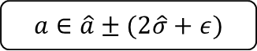

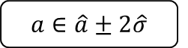
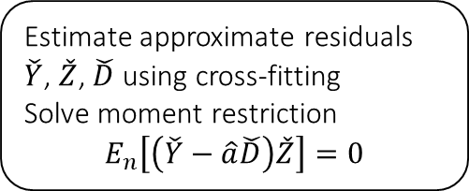
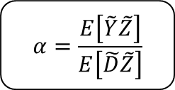


Causal Inference Pipeline
Data Collection
Estimation
(training)
Validation
(testing)
Domain Assumption Elicitation
Identification
Inference (Confidence Intervals)
DAGs/ASEMs
Estimate approximate residuals $\check{Y}$, $\check{Z}$, $\check{D}$ using cross-fitting
Solve moment restriction
$$E_{n}\left[\left(\check{Y}−\hat{a}\check{D}\right)\check{Z}\right]=0$$
Theory
$$Z$$
$$D$$
$$α=\frac{E\left[\tilde{Y}\tilde{Z}\right]}{E\left[\tilde{D}\tilde{Z}\right]}$$
$$a∈\hat{a}±2\hat{σ}$$
$$X$$
$$Y$$
Instrumental Variable: any random variable Z that affects the treatment (log-price) D but does not affect the outcome (log-demand) Y other than through the treatment
Sensitivity Analysis
Practice
$$a∈\hat{a}±(2\hat{σ}+ε)$$
Adaptive Experiments
Decision
Policy

Slide 6
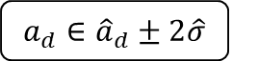

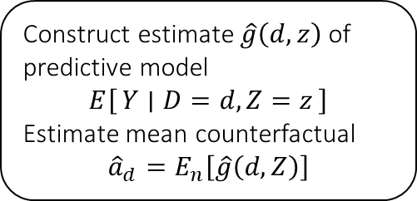
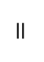
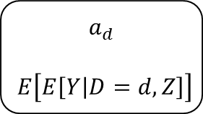
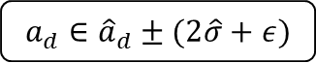
Causal Inference Pipeline
Data Collection
Estimation
(training)
Validation
(testing)
Domain Assumption Elicitation
Identification
Inference (Confidence Intervals)
DAGs/ASEMs
Construct estimate $\hat{g}\left(d,z\right)$ of predictive model
$$E\left[Y ∣ D=d,Z=z\right]$$
Estimate mean counterfactual
$${\hat{a}}_{d}=E_{n}\left[\hat{g}\left(d,Z\right)\right]$$
Theory
$$a_{d}$$
$$E\left[E\left[Y | D=d,Z\right]\right]$$
$$D$$
$$=$$
$$a_{d}∈{\hat{a}}_{d}±2\hat{σ}$$
$$Z$$
$$Y$$
Who should we treat?
Sensitivity Analysis
Practice
$$a_{d}∈{\hat{a}}_{d}±(2\hat{σ}+ε)$$
Adaptive Experiments
Decision
Policy

Slide 7
Conditional Average Treatment Effects (CATE)
aka Heterogeneous Treatment Effects

Slide 8
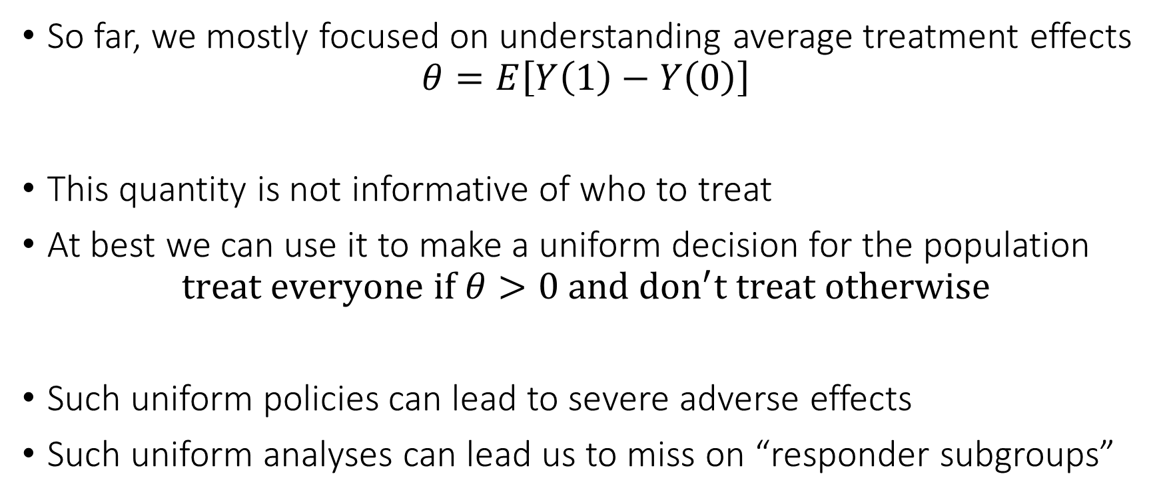
Problem with Average Treatment Effect
So far, we mostly focused on understanding average treatment effects
$$θ=E\left[Y\left(1\right)−Y\left(0\right)\right]$$
This quantity is not informative of who to treat
At best we can use it to make a uniform decision for the population
$$treat everyone if θ>0 and don^{′}t treat otherwise$$
Such uniform policies can lead to severe adverse effects
Such uniform analyses can lead us to miss on “responder subgroups”

Slide 9
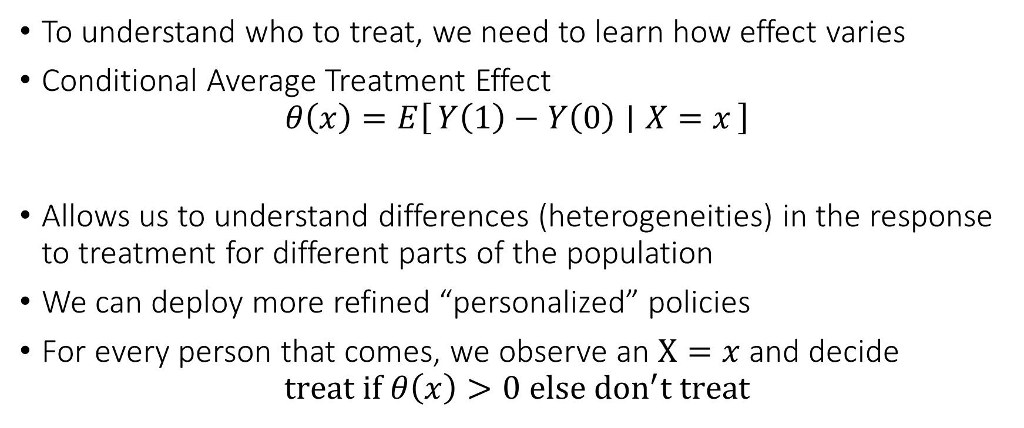
Personalized (Refined) Policies
To understand who to treat, we need to learn how effect varies
Conditional Average Treatment Effect
$$θ\left(x\right)=E\left[Y\left(1\right)−Y\left(0\right) ∣ X=x\right]$$
Allows us to understand differences (heterogeneities) in the response to treatment for different parts of the population
We can deploy more refined “personalized” policies
For every person that comes, we observe an $X=x$ and decide
$$treat if θ\left(x\right)>0 else don^{′}t treat$$

Slide 10
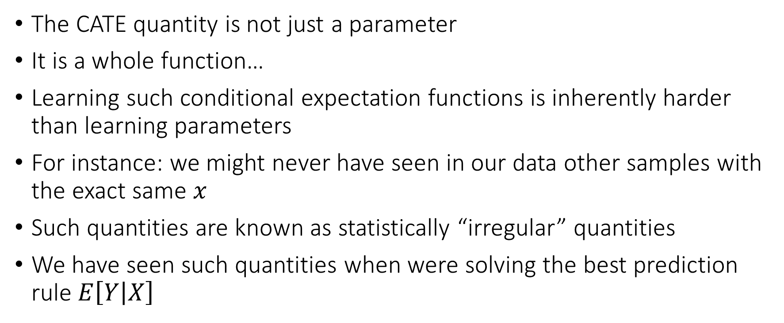
The intrinsic hardness of CATE
The CATE quantity is not just a parameter
It is a whole function…
Learning such conditional expectation functions is inherently harder than learning parameters
For instance: we might never have seen in our data other samples with the exact same $x$
Such quantities are known as statistically “irregular” quantities
We have seen such quantities when were solving the best prediction rule $E\left[Y | X\right]$

Slide 11
The intrinsic hardness of CATE
Estimating CATE at least as hard as estimating the best prediction rule
Inherently harder than estimating an “average”
So far for our target causal quantities we wanted fast estimation rates and confidence intervals
We were only ok with “decent” estimation rates for the auxiliary (nuisance) predictive models that entered our analysis
We might want to relax our goals…

Slide 12
Different Approaches to Relaxing our Goals
Goal 1: Maybe estimate a simpler projection (e.g. analogue of BLP)
Goal 2: Confidence intervals for predictions of this simple projection
Goal 3: Simultaneous confidence bands for predictions of this simple projection
Goal 4: Estimation error rate for the true CATE
Goal 5: Confidence intervals for the prediction of a CATE model
Goal 6: Simultaneous confidence bands for joint predictions of CATE model
Policy Learning
Goal 7: Go after optimal simple treatment policies; give me a policy with value close to the best
Goal 8: Inference on value of candidate treatment policies
Goal 9: Inference on value of optimal policy
Goal 10: Identify responder or heterogeneous sub-groups; policies with statistical significance;
Linear Doubly Robust Learner
Meta-learner approaches: S-Learner, T-Learner, X-Learner, R-Learner, DR-Learner
Neural Network approaches: TARNet, CFR
Random Forest approaches: BART
Modified (honest) ML methods: Generalized Random Forest, Orthogonal Random Forest, Sub-sampled Nearest Neighbor Regression
?? (only classical non-parametric statistic results on confidence bands of non-parametric functions)
Doubly Robust Policy Learning
Doubly Robust Policy Evaluation

Slide 13
Different Approaches to Relaxing our Goals
Goal 1: Maybe estimate a simpler projection (e.g. analogue of BLP)
Goal 2: Confidence intervals for predictions of this simple projection
Goal 3: Simultaneous confidence bands for predictions of this simple projection
Goal 4: Estimation error rate for the true CATE
Goal 5: Confidence intervals for the prediction of a CATE model
Goal 6: Simultaneous confidence bands for joint predictions of CATE model
Policy Learning
Goal 7: Go after optimal simple treatment policies; give me a policy with value close to the best
Goal 8: Inference on value of candidate treatment policies
Goal 9: Inference on value of optimal policy
Goal 10: Identify responder or heterogeneous sub-groups; policies with statistical significance;
Linear Doubly Robust Learner
Meta-learner approaches: S-Learner, T-Learner, X-Learner, R-Learner, DR-Learner
Neural Network approaches: TARNet, CFR
Random Forest approaches: BART
Modified (honest) ML methods: Generalized Random Forest, Orthogonal Random Forest, Sub-sampled Nearest Neighbor Regression
?? (only classical non-parametric statistic results on confidence bands of non-parametric functions)
Doubly Robust Policy Learning
Doubly Robust Policy Evaluation

Slide 14
Best Linear Projection of CATE

Slide 15
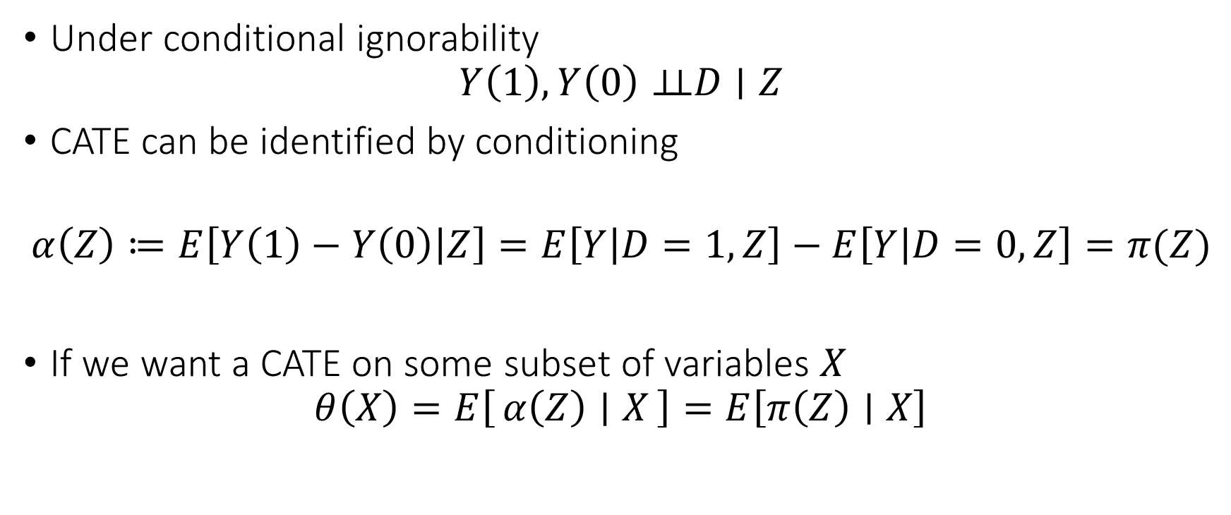
Identification by Conditioning
Under conditional ignorability
$$Y\left(1\right),Y\left(0\right)⊥⊥D∣Z$$
CATE can be identified by conditioning
$$α\left(Z\right)≔E\left[Y\left(1\right)−Y\left(0\right) | Z\right]=E\left[Y | D=1,Z\right]−E\left[Y | D=0,Z\right]=π(Z)$$
If we want a CATE on some subset of variables $X$
$$θ\left(X\right)=E\left[α\left(Z\right) ∣ X\right]=E\left[π\left(Z\right)∣X\right]$$

Slide 16
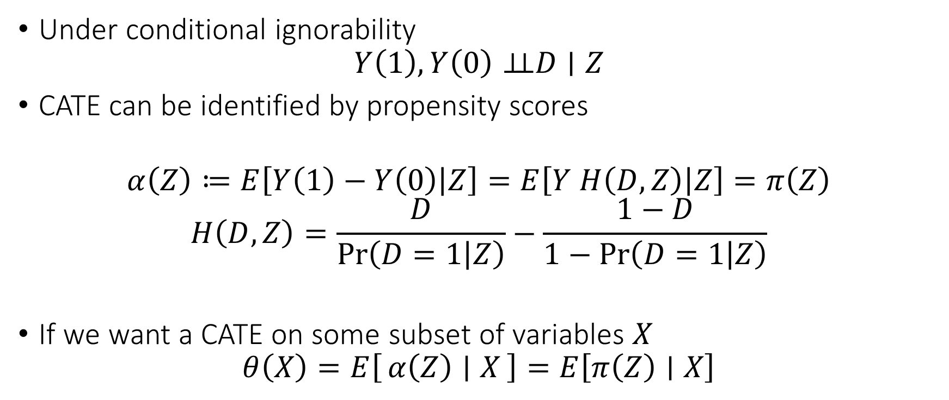
Identification with Propensity Scores
Under conditional ignorability
$$Y\left(1\right),Y\left(0\right)⊥⊥D∣Z$$
CATE can be identified by propensity scores
$$α\left(Z\right)≔E\left[Y\left(1\right)−Y\left(0\right) | Z\right]=E\left[Y H\left(D, Z\right) | Z\right]=π\left(Z\right)$$
$$H\left(D,Z\right)=\frac{D}{\operatorname{Pr}\left(D=1 | Z\right)}−\frac{1−D}{1−\operatorname{Pr}\left(D=1 | Z\right)}$$
If we want a CATE on some subset of variables $X$
$$θ\left(X\right)=E\left[α\left(Z\right) ∣ X\right]=E\left[π\left(Z\right)∣X\right]$$

Slide 17
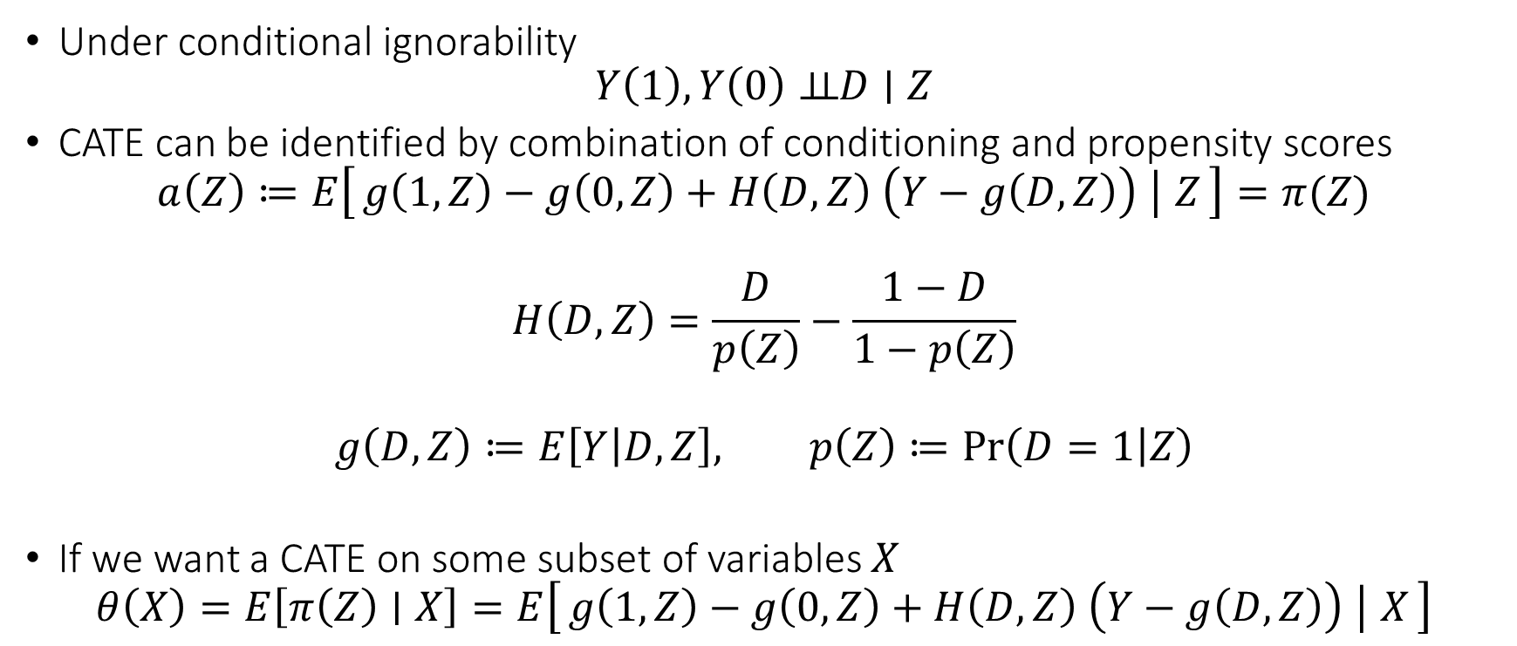
Doubly Robust Identification
Under conditional ignorability
$$Y\left(1\right),Y\left(0\right)⊥⊥D∣Z$$
CATE can be identified by combination of conditioning and propensity scores
$$a\left(Z\right)≔E\left[g\left(1, Z\right)−g\left(0, Z\right)+H\left(D,Z\right) \left(Y−g\left(D,Z\right)\right) ∣ Z\right]=π(Z)$$
$$H\left(D,Z\right)=\frac{D}{p\left(Z\right)}−\frac{1−D}{1−p\left(Z\right)}$$
$$g\left(D,Z\right)≔E\left[Y | D,Z\right], p\left(Z\right)≔\operatorname{Pr}\left(D=1 | Z\right)$$
If we want a CATE on some subset of variables $X$
$$θ\left(X\right)=E\left[π\left(Z\right)∣X\right]=E\left[g\left(1, Z\right)−g\left(0, Z\right)+H\left(D,Z\right) \left(Y−g\left(D,Z\right)\right) ∣ X\right]$$

Slide 18
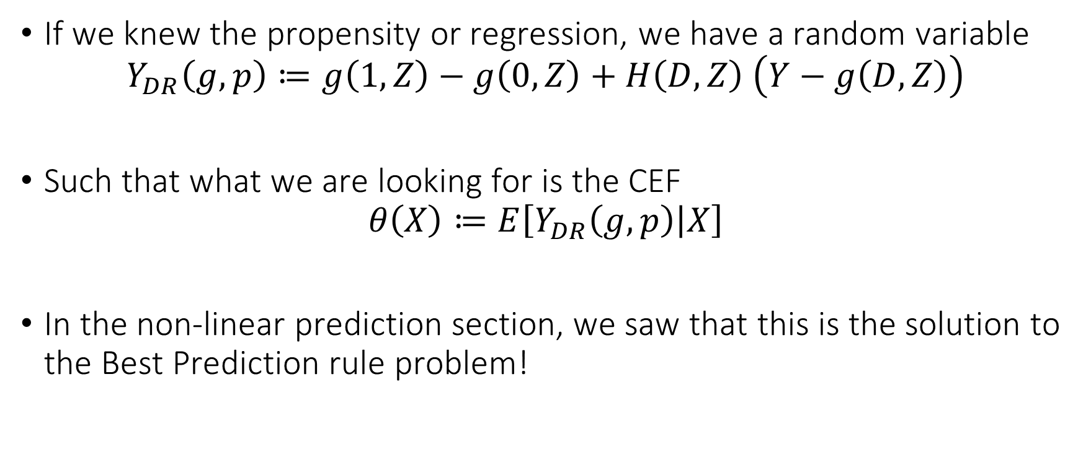
From Identification to Estimation
If we knew the propensity or regression, we have a random variable
$$Y_{DR}\left(g,p\right)≔g\left(1, Z\right)−g\left(0, Z\right)+H\left(D,Z\right) \left(Y−g\left(D,Z\right)\right)$$
Such that what we are looking for is the CEF
$$θ\left(X\right)≔E\left[Y_{DR}\left(g,p\right) | X\right]$$
In the non-linear prediction section, we saw that this is the solution to the Best Prediction rule problem!

Slide 19
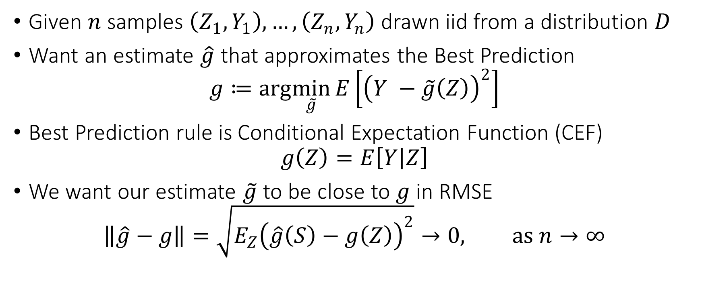
Blast from the Past: Best Prediction Rule
Given $n$ samples $\left(Z_{1},Y_{1}\right),…,\left(Z_{n},Y_{n}\right)$ drawn iid from a distribution $D$
Want an estimate $\hat{g}$ that approximates the Best Prediction
$$g≔arg\min_{\tilde{g}}{E\left[{\left(Y −\tilde{g}\left(Z\right)\right)}^{2}\right]}$$
Best Prediction rule is Conditional Expectation Function (CEF)
$$g\left(Z\right)=E\left[Y | Z\right]$$
We want our estimate $\tilde{g}$ to be close to $g$ in RMSE
$$\left\|\hat{g}−g\right\|=\sqrt{E_{Z}{\left(\hat{g}\left(S\right)−g\left(Z\right)\right)}^{2}}→0, as n→∞$$

Slide 20
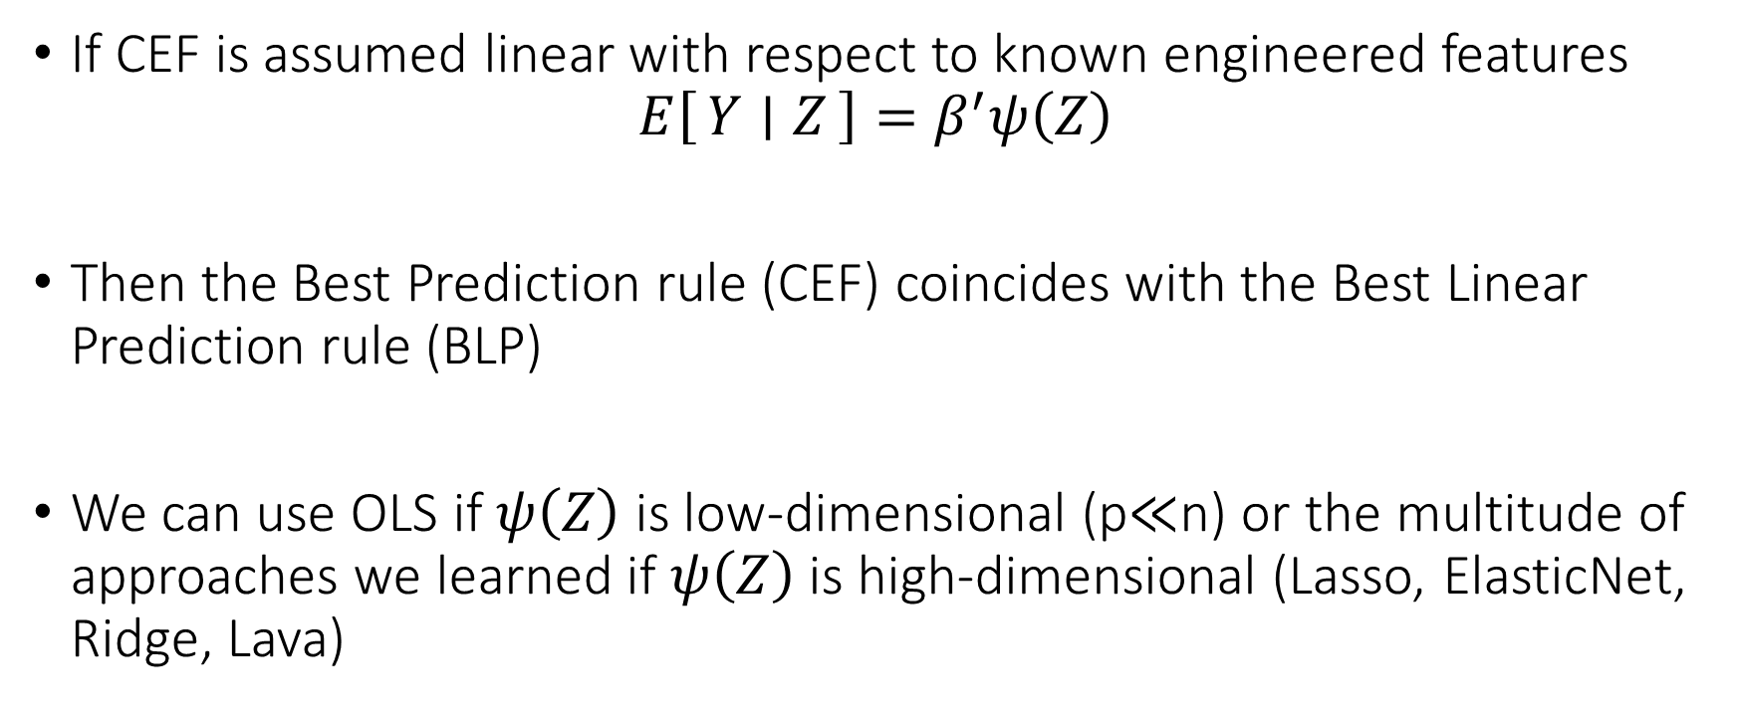
Blast from the Past: Linear CEF
If CEF is assumed linear with respect to known engineered features
$$E\left[Y ∣ Z\right]=β^{′}ψ\left(Z\right)$$
Then the Best Prediction rule (CEF) coincides with the Best Linear Prediction rule (BLP)
We can use OLS if $ψ\left(Z\right)$ is low-dimensional (p$≪$n) or the multitude of approaches we learned if $ψ\left(Z\right)$ is high-dimensional (Lasso, ElasticNet, Ridge, Lava)

Slide 21
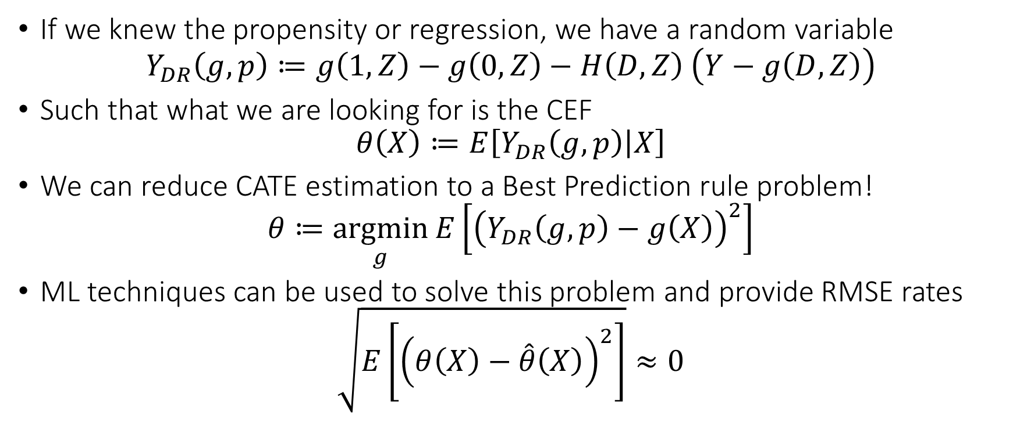
From Identification to Estimation
If we knew the propensity or regression, we have a random variable
$$Y_{DR}\left(g,p\right)≔g\left(1, Z\right)−g\left(0, Z\right)−H\left(D,Z\right) \left(Y−g\left(D,Z\right)\right)$$
Such that what we are looking for is the CEF
$$θ\left(X\right)≔E\left[Y_{DR}\left(g,p\right) | X\right]$$
We can reduce CATE estimation to a Best Prediction rule problem!
$$θ≔\underset{g}{argmin}{E\left[{\left(Y_{DR}\left(g,p\right)−g\left(X\right)\right)}^{2}\right]}$$
ML techniques can be used to solve this problem and provide RMSE rates
$$\sqrt{E\left[{\left(θ\left(X\right)−\hat{θ}\left(X\right)\right)}^{2}\right]}≈0$$

Slide 22

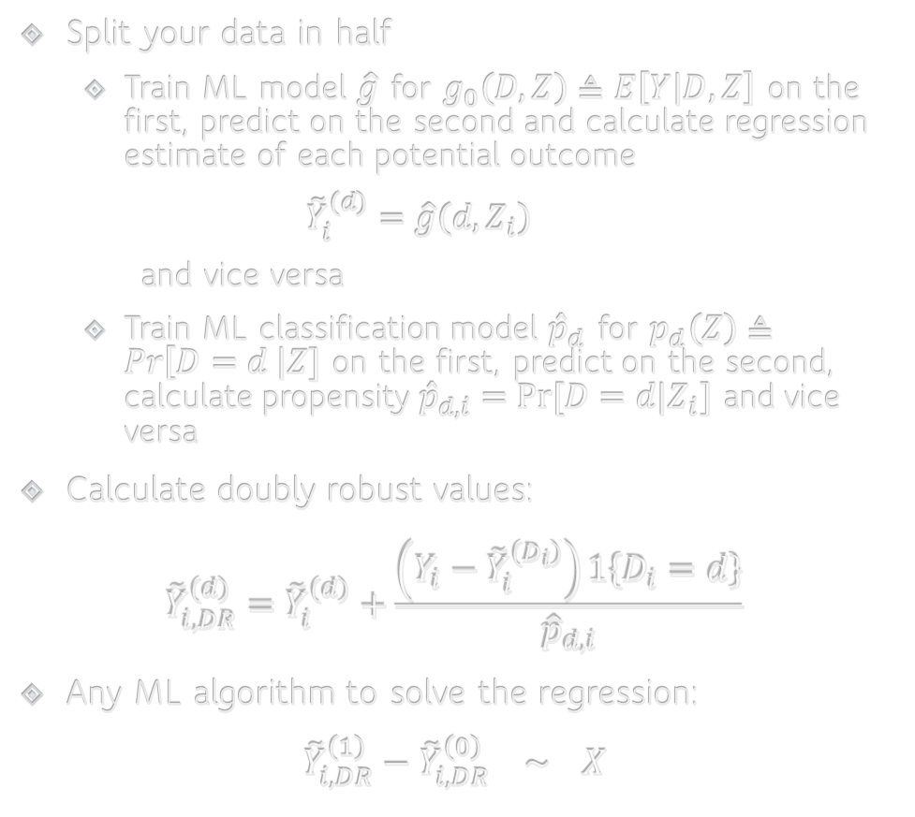
Doubly Robust Learning [Foster, Syrgkanis, ‘19 Orthogonal Statistical Learning]
Split your data in half
Train ML model $\hat{g}$ for $g_{0}\left(D,Z\right)≜E\left[Y | D,Z\right]$ on the first, predict on the second and calculate regression estimate of each potential outcome
$${\tilde{Y}}_{i}^{(d)}=\hat{g}\left(d, Z_{i}\right)$$
and vice versa
Train ML classification model ${\hat{p}}_{d}$ for $p_{d}\left(Z\right)≜Pr\left[D=d \right|Z]$ on the first, predict on the second, calculate propensity ${\hat{p}}_{d,i}=Pr⁡[D=d|Z_{i}]$ and vice versa
Calculate doubly robust values:
$${\tilde{Y}}_{i,DR}^{(d)}={\tilde{Y}}_{i}^{(d)}+\frac{\left(Y_{i}−{\tilde{Y}}_{i}^{\left(D_{i}\right)}\right)1\left\{D_{i}=d\right\}}{{\hat{p}}_{d,i}}$$
Any ML algorithm to solve the regression:
$${\tilde{Y}}_{i,DR}^{\left(1\right)}−{\tilde{Y}}_{i,DR}^{\left(0\right)} \sim X$$

Slide 23
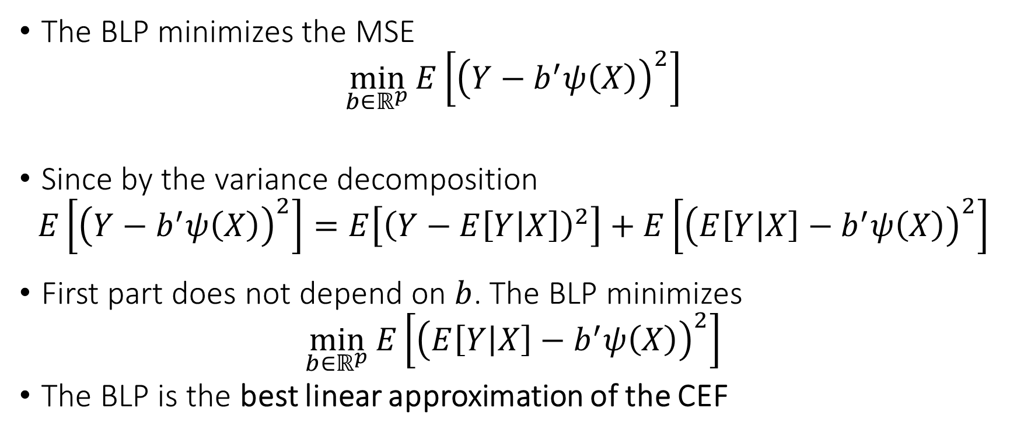
Blast from the Past: Best Linear Prediction (BLP) Problem
The BLP minimizes the MSE
$$\min_{b∈ℝ^{p}}{E\left[{\left(Y−b^{′}ψ\left(X\right)\right)}^{2}\right]}$$
Since by the variance decomposition
$$E\left[{\left(Y−b^{′}ψ\left(X\right)\right)}^{2}\right]=E\left[{\left(Y−E\left[Y | X\right]\right)}^{2}\right]+E\left[{\left(E\left[Y | X\right]−b^{′}ψ\left(X\right)\right)}^{2}\right]$$
First part does not depend on $b$. The BLP minimizes
$$\min_{b∈ℝ^{p}}{E\left[{\left(E\left[Y | X\right]−b^{′}ψ\left(X\right)\right)}^{2}\right]}$$
The BLP is the best linear approximation of the CEF

Slide 24
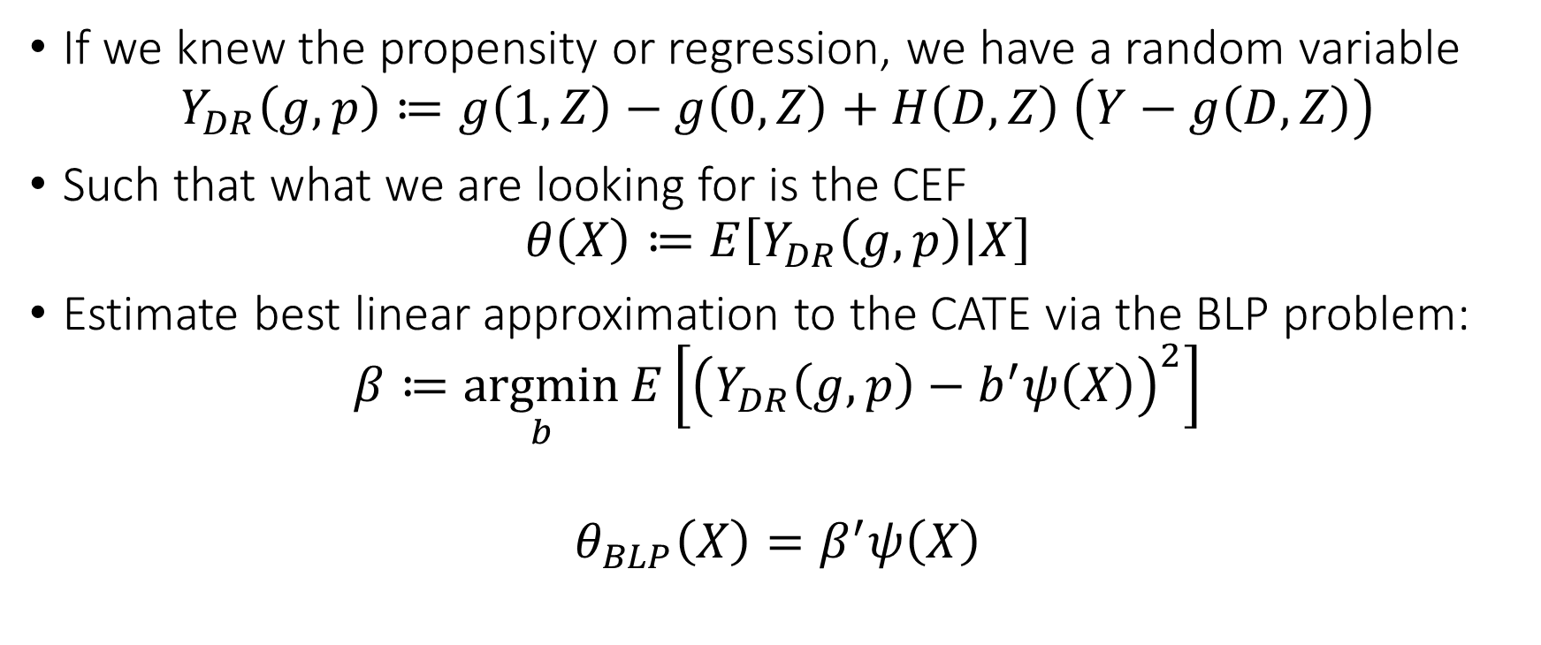
From Identification to Estimation
If we knew the propensity or regression, we have a random variable
$$Y_{DR}\left(g,p\right)≔g\left(1, Z\right)−g\left(0, Z\right)+H\left(D,Z\right) \left(Y−g\left(D,Z\right)\right)$$
Such that what we are looking for is the CEF
$$θ\left(X\right)≔E\left[Y_{DR}\left(g,p\right) | X\right]$$
Estimate best linear approximation to the CATE via the BLP problem:
$$β≔\underset{b}{argmin}{E\left[{\left(Y_{DR}\left(g,p\right)−b^{′}ψ\left(X\right)\right)}^{2}\right]}$$
$$θ_{BLP}\left(X\right)=β^{′}ψ\left(X\right)$$

Slide 25
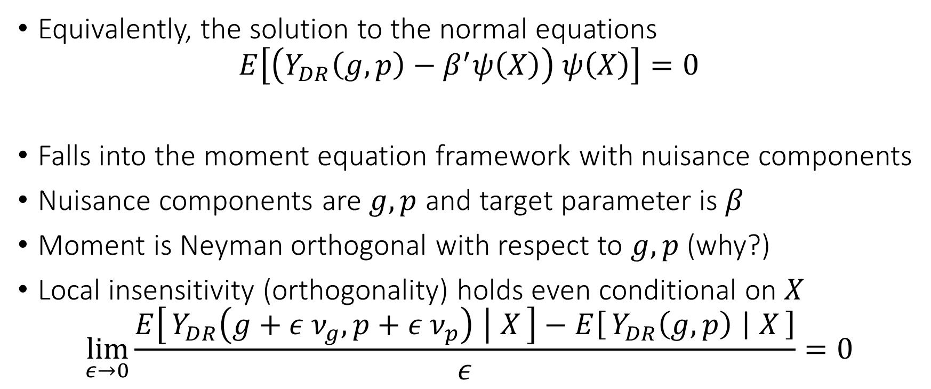
Normal Equations
Equivalently, the solution to the normal equations
$$E\left[\left(Y_{DR}\left(g,p\right)−β^{′}ψ\left(X\right)\right) ψ\left(X\right)\right]=0$$
Falls into the moment equation framework with nuisance components
Nuisance components are $g,p$ and target parameter is $β$
Moment is Neyman orthogonal with respect to $g,p$ (why?)
Local insensitivity (orthogonality) holds even conditional on $X$
$$\lim_{ε→0}{\frac{E\left[Y_{DR}\left(g+ε ν_{g},p+ε ν_{p}\right) ∣ X\right]−E\left[Y_{DR}\left(g,p\right) ∣ X\right]}{ε}}=0$$

Slide 26
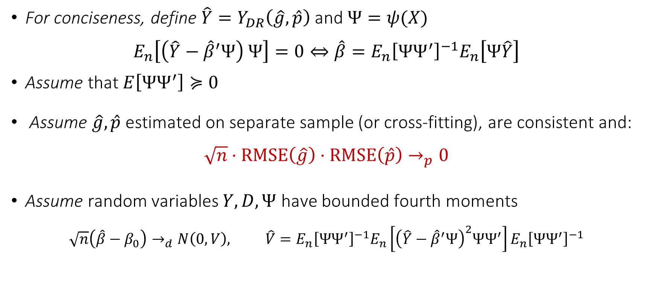
Asymptotic Normality
For conciseness, define $\hat{Y}=Y_{DR}\left(\hat{g},\hat{p}\right)$ and $Ψ=ψ(X)$
$$E_{n}\left[\left(\hat{Y}−{\hat{β}}^{′}Ψ\right) Ψ\right]=0⇔\hat{β}=E_{n}{\left[ΨΨ^{′}\right]}^{−1}E_{n}\left[Ψ\hat{Y}\right]$$
Assume that $E\left[ΨΨ^{′}\right]≽0$
Assume $\hat{g},\hat{p}$ estimated on separate sample (or cross-fitting), are consistent and:
$$\sqrt{n}⋅RMSE\left(\hat{g}\right)⋅RMSE\left(\hat{p}\right)→_{p}0$$
Assume random variables $Y,D,Ψ$ have bounded fourth moments
$$\sqrt{n}\left(\hat{β}−β_{0}\right)→_{d}N\left(0,V\right), \hat{V}=E_{n}{\left[ΨΨ^{′}\right]}^{−1}E_{n}\left[{\left(\hat{Y}−{\hat{β}}^{′}Ψ\right)}^{2}ΨΨ^{′}\right]E_{n}{\left[ΨΨ^{′}\right]}^{−1}$$
Estimate asymptotically normal
“Sandwich” estimate of variance (HC0 in OLS packages)

Slide 27
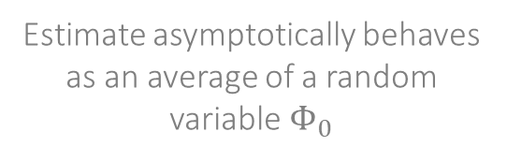
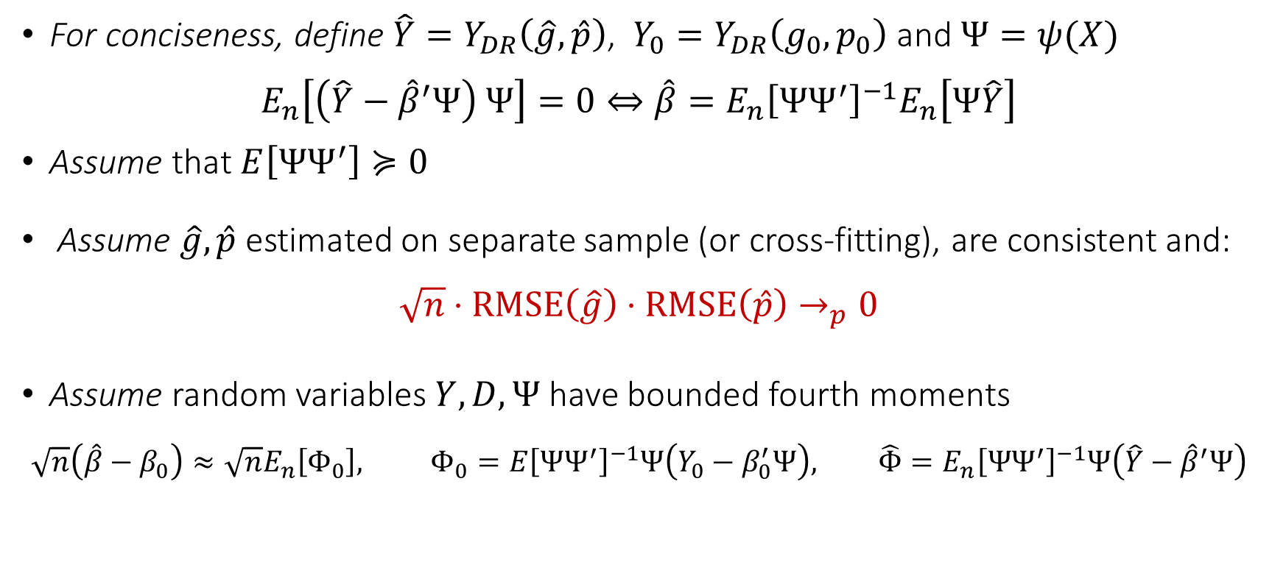
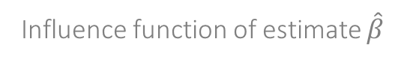
Asymptotic Linearity
For conciseness, define $\hat{Y}=Y_{DR}\left(\hat{g},\hat{p}\right)$, $Y_{0}=Y_{DR}\left(g_{0},p_{0}\right)$ and $Ψ=ψ(X)$
$$E_{n}\left[\left(\hat{Y}−{\hat{β}}^{′}Ψ\right) Ψ\right]=0⇔\hat{β}=E_{n}{\left[ΨΨ^{′}\right]}^{−1}E_{n}\left[Ψ\hat{Y}\right]$$
Assume that $E\left[ΨΨ^{′}\right]≽0$
Assume $\hat{g},\hat{p}$ estimated on separate sample (or cross-fitting), are consistent and:
$$\sqrt{n}⋅RMSE\left(\hat{g}\right)⋅RMSE\left(\hat{p}\right)→_{p}0$$
Assume random variables $Y,D,Ψ$ have bounded fourth moments
$$\sqrt{n}\left(\hat{β}−β_{0}\right)≈\sqrt{n}E_{n}\left[Φ_{0}\right], Φ_{0}=E{\left[ΨΨ^{′}\right]}^{−1}Ψ\left(Y_{0}−β_{0}^{′}Ψ\right), \hat{Φ}=E_{n}{\left[ΨΨ^{′}\right]}^{−1}Ψ\left(\hat{Y}−{\hat{β}}^{′}Ψ\right)$$
Estimate asymptotically behaves as an average of a random variable $Φ_{0}$
Influence function of estimate $\hat{β}$
Estimate of influence function

Slide 28
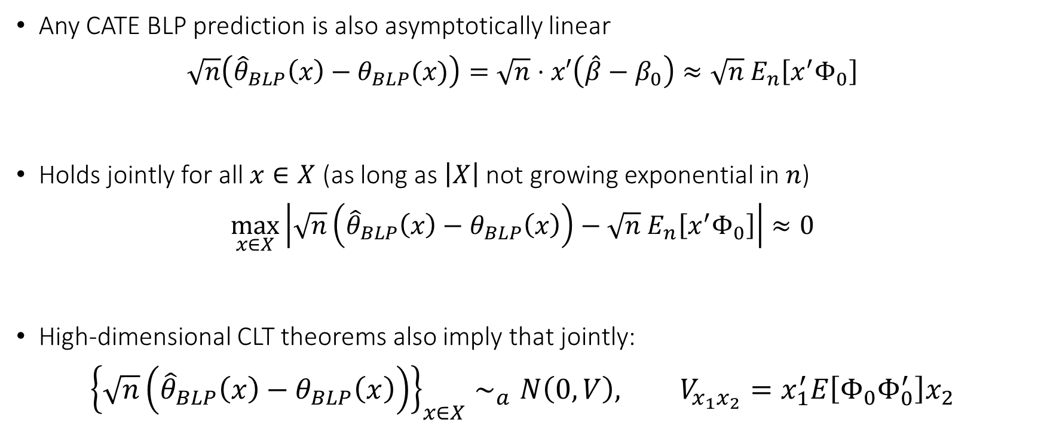
Confidence Bands
Any CATE BLP prediction is also asymptotically linear
$$\sqrt{n}\left({\hat{θ}}_{BLP}\left(x\right)−θ_{BLP}(x)\right)=\sqrt{n}⋅x′\left(\hat{β}−β_{0}\right)≈\sqrt{n} E_{n}\left[x^{′}Φ_{0}\right]$$
Holds jointly for all $x∈X$ (as long as $\left|X\right|$ not growing exponential in $n$)
$$\max_{x∈X}\left|\sqrt{n}\left({\hat{θ}}_{BLP}\left(x\right)−θ_{BLP}\left(x\right)\right)−\sqrt{n} E_{n}\left[x^{′}Φ_{0}\right]\right|≈0$$
High-dimensional CLT theorems also imply that jointly:
$${\left\{\sqrt{n}\left({\hat{θ}}_{BLP}\left(x\right)−θ_{BLP}\left(x\right)\right)\right\}}_{x∈X}∼_{a}N\left(0,V\right), V_{x_{1}x_{2}}=x_{1}^{′}E\left[Φ_{0}Φ_{0}^{′}\right]x_{2}$$

Slide 29
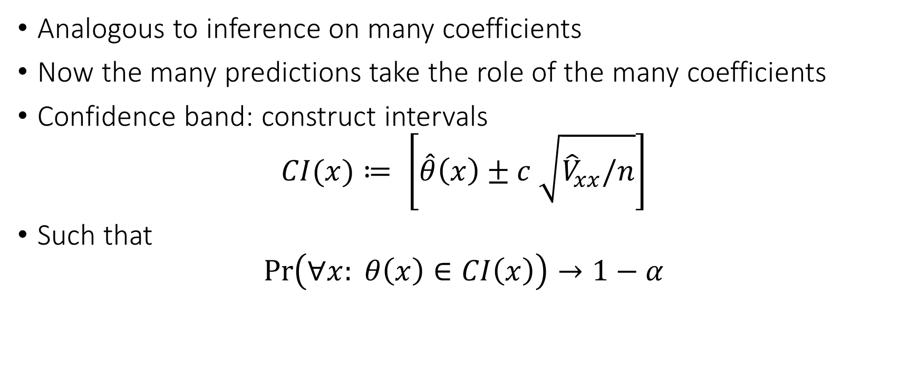
Confidence Bands
Analogous to inference on many coefficients
Now the many predictions take the role of the many coefficients
Confidence band: construct intervals
$$CI(x)≔ \left[\hat{θ}\left(x\right)±c \sqrt{{\hat{V}}_{xx}/n}\right]$$
Such that
$$\operatorname{Pr}\left(∀x: θ\left(x\right)∈CI\left(x\right)\right)→1−α$$

Slide 30
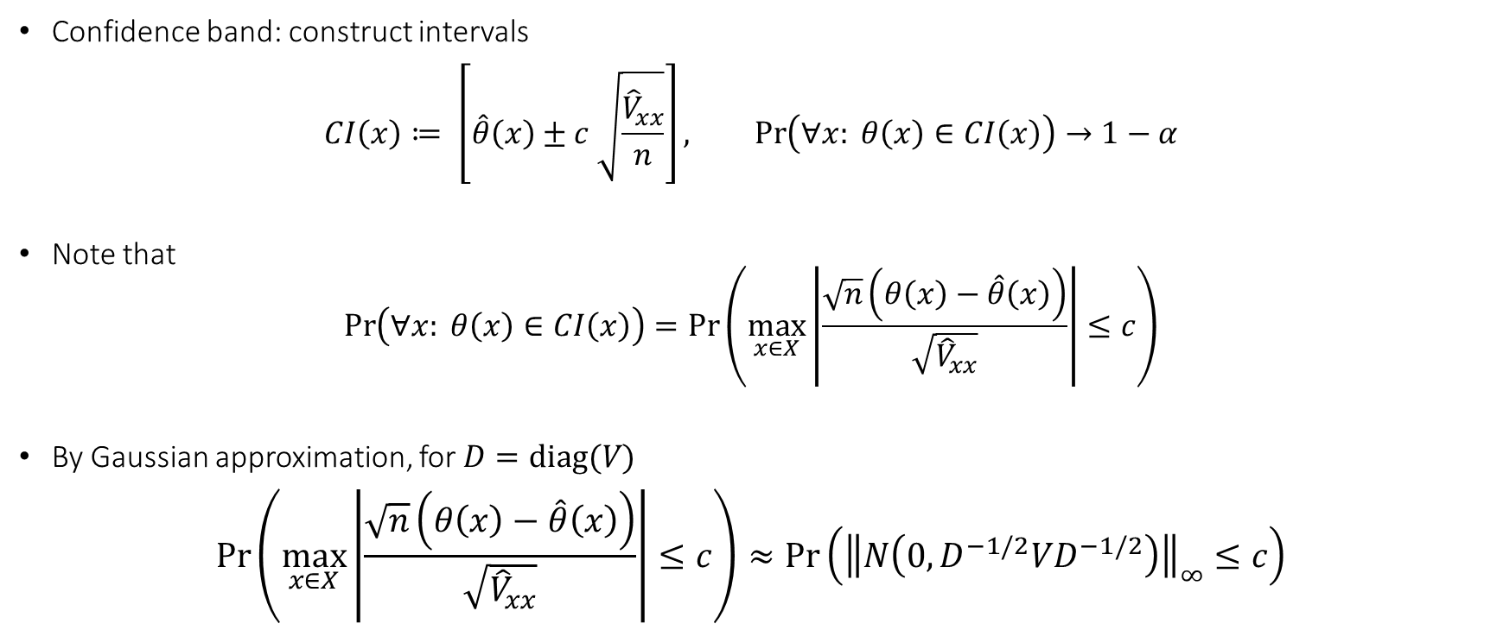
Confidence Bands
Confidence band: construct intervals
$$CI\left(x\right)≔ \left[\hat{θ}\left(x\right)±c \sqrt{\frac{{\hat{V}}_{xx}}{n}}\right], \operatorname{Pr}\left(∀x: θ\left(x\right)∈CI\left(x\right)\right)→1−α$$
Note that
$$\operatorname{Pr}\left(∀x: θ\left(x\right)∈CI\left(x\right)\right)=\operatorname{Pr}\left(\max_{x∈X}\left|\frac{\sqrt{n}\left(θ\left(x\right)−\hat{θ}\left(x\right)\right)}{\sqrt{{\hat{V}}_{xx}}}\right|≤c\right)$$
By Gaussian approximation, for $D=diag(V)$
$$\operatorname{Pr}\left(\max_{x∈X}\left|\frac{\sqrt{n}\left(θ\left(x\right)−\hat{θ}\left(x\right)\right)}{\sqrt{{\hat{V}}_{xx}}}\right|≤c\right)≈\operatorname{Pr}\left({\left\|N\left(0, D^{−1/2}VD^{−1/2}\right)\right\|}_{∞}≤c\right)$$

Slide 31

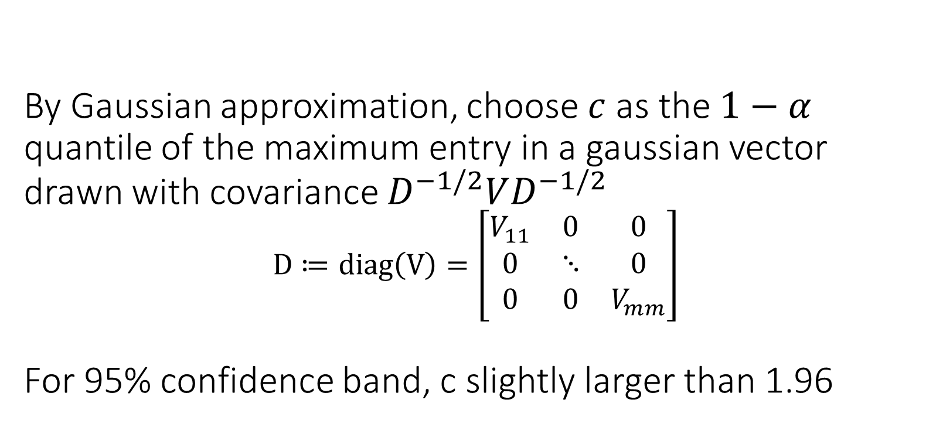
By Gaussian approximation, choose $c$ as the $1−α$ quantile of the maximum entry in a gaussian vector drawn with covariance $D^{−1/2}VD^{−1/2}$ $$D≔diag\left(V\right)=\left[\begin{matrix}V_{11} & 0 & 0 \\ 0 & ⋱ & 0 \\ 0 & 0 & V_{mm}\end{matrix}\right]$$ For 95% confidence band, c slightly larger than 1.96

Slide 32
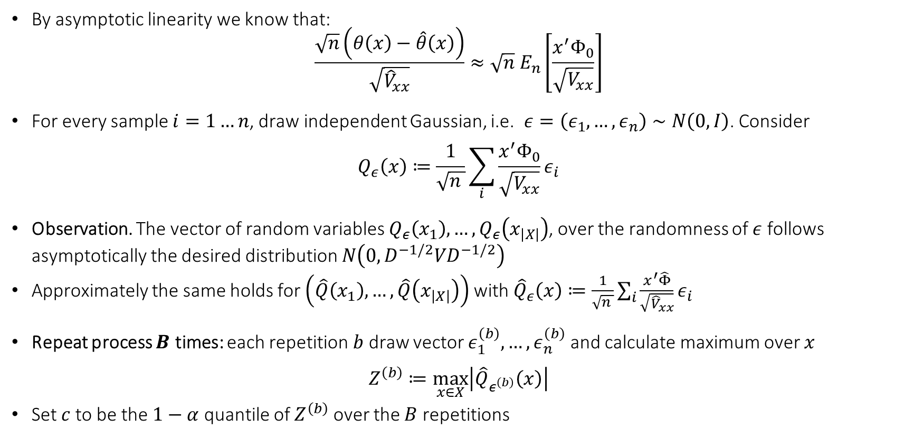
Computationally Friendlier Version: Multiplier Bootstrap
By asymptotic linearity we know that:
$$\frac{\sqrt{n}\left(θ\left(x\right)−\hat{θ}\left(x\right)\right)}{\sqrt{{\hat{V}}_{xx}}}≈\sqrt{n} E_{n}\left[\frac{x^{′}Φ_{0}}{\sqrt{V_{xx}}}\right]$$
For every sample $i=1…n$, draw independent Gaussian, i.e. $ε=\left(ε_{1},…,ε_{n}\right)∼N\left(0, I\right)$. Consider
$$Q_{ε}\left(x\right)≔\frac{1}{\sqrt{n }}\sum_{i}{\frac{x^{′}Φ_{0}}{\sqrt{V_{xx}}}ε_{i}}$$
Observation. The vector of random variables $Q_{ε}\left(x_{1}\right), …,Q_{ε}\left(x_{\left|X\right|}\right)$, over the randomness of $ε$ follows asymptotically the desired distribution $N\left(0, D^{−1/2}VD^{−1/2}\right)$
Approximately the same holds for $\left(\hat{Q}\left(x_{1}\right), …, \hat{Q}\left(x_{\left|X\right|}\right)\right)$ with ${\hat{Q}}_{ε}\left(x\right)≔\frac{1}{\sqrt{n }}\sum_{i}{\frac{x^{′}\hat{Φ}}{\sqrt{{\hat{V}}_{xx}}}ε_{i}}$
Repeat process $B$ times: each repetition $b$ draw vector $ε_{1}^{\left(b\right)},…,ε_{n}^{\left(b\right)}$ and calculate maximum over $x$
$$Z^{\left(b\right)}≔\max_{x∈X}\left|{\hat{Q}}_{ε^{\left(b\right)}}\left(x\right)\right|$$
Set $c$ to be the $1−α$ quantile of $Z^{\left(b\right)}$ over the $B$ repetitions

Slide 33
Different Approaches to Relaxing our Goals
Goal 1: Maybe estimate a simpler projection (e.g. analogue of BLP)
Goal 2: Confidence intervals for predictions of this simple projection
Goal 3: Simultaneous confidence bands for predictions of this simple projection
Goal 4: Estimation error rate for the true CATE
Goal 5: Confidence intervals for the prediction of a CATE model
Goal 6: Simultaneous confidence bands for joint predictions of CATE model
Policy Learning
Goal 7: Go after optimal simple treatment policies; give me a policy with value close to the best
Goal 8: Inference on value of candidate treatment policies
Goal 9: Inference on value of optimal policy
Goal 10: Identify responder or heterogeneous sub-groups; policies with statistical significance;
Linear Doubly Robust Learner
Meta-learner approaches: S-Learner, T-Learner, X-Learner, R-Learner, DR-Learner
Neural Network approaches: TARNet, CFR
Random Forest approaches: BART
Modified (honest) ML methods: Generalized Random Forest, Orthogonal Random Forest, Sub-sampled Nearest Neighbor Regression
?? (only classical non-parametric statistic results on confidence bands of non-parametric functions)
Doubly Robust Policy Learning
Doubly Robust Policy Evaluation

Slide 34
Non-Parametric Confidence Intervals

Slide 35
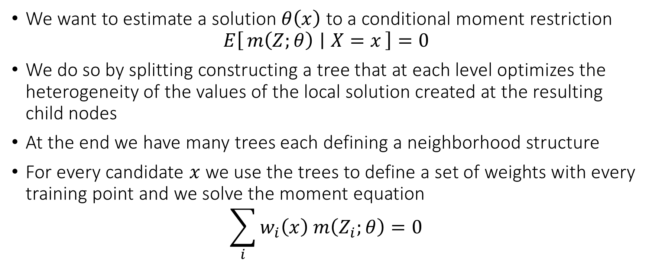
Generalized Random Forest
We want to estimate a solution $θ\left(x\right)$ to a conditional moment restriction
$$E\left[m\left(Z;θ\right) ∣ X=x\right]=0$$
We do so by splitting constructing a tree that at each level optimizes the heterogeneity of the values of the local solution created at the resulting child nodes
At the end we have many trees each defining a neighborhood structure
For every candidate $x$ we use the trees to define a set of weights with every training point and we solve the moment equation
$$\sum_{i}{w_{i}\left(x\right) m\left(Z_{i};θ\right)}=0$$

Slide 36
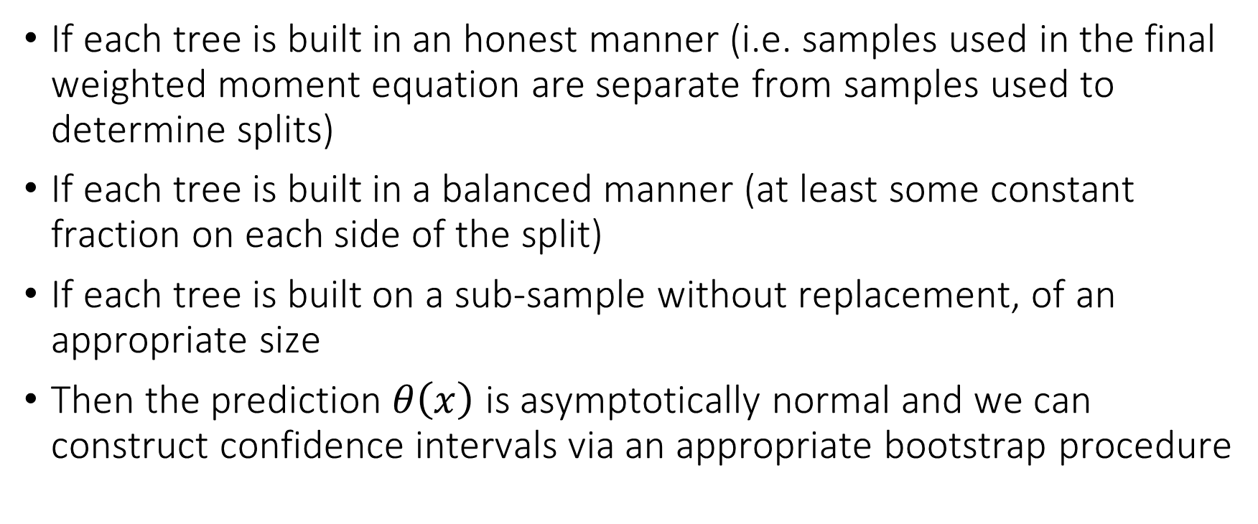
Generalized Random Forest
If each tree is built in an honest manner (i.e. samples used in the final weighted moment equation are separate from samples used to determine splits)
If each tree is built in a balanced manner (at least some constant fraction on each side of the split)
If each tree is built on a sub-sample without replacement, of an appropriate size
Then the prediction $θ\left(x\right)$ is asymptotically normal and we can construct confidence intervals via an appropriate bootstrap procedure

Slide 37
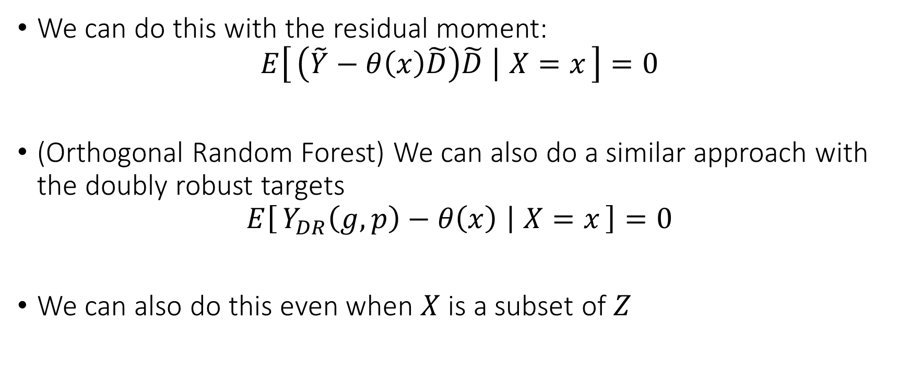
GRF for CATE
We can do this with the residual moment:
$$E\left[\left(\tilde{Y}−θ\left(x\right)\tilde{D}\right)\tilde{D} ∣ X=x\right]=0$$
(Orthogonal Random Forest) We can also do a similar approach with the doubly robust targets
$$E\left[Y_{DR}\left(g,p\right)−θ\left(x\right) ∣ X=x\right]=0$$
We can also do this even when $X$ is a subset of $Z$

Slide 38
Different Approaches to Relaxing our Goals
Goal 1: Maybe estimate a simpler projection (e.g. analogue of BLP)
Goal 2: Confidence intervals for predictions of this simple projection
Goal 3: Simultaneous confidence bands for predictions of this simple projection
Goal 4: Estimation error rate for the true CATE
Goal 5: Confidence intervals for the prediction of a CATE model
Goal 6: Simultaneous confidence bands for joint predictions of CATE model
Policy Learning
Goal 7: Go after optimal simple treatment policies; give me a policy with value close to the best
Goal 8: Inference on value of candidate treatment policies
Goal 9: Inference on value of optimal policy
Goal 10: Identify responder or heterogeneous sub-groups; policies with statistical significance;
Linear Doubly Robust Learner
Meta-learner approaches: S-Learner, T-Learner, X-Learner, R-Learner, DR-Learner
Neural Network approaches: TARNet, CFR
Random Forest approaches: BART
Modified (honest) ML methods: Generalized Random Forest, Orthogonal Random Forest, Sub-sampled Nearest Neighbor Regression
?? (only classical non-parametric statistic results on confidence bands of non-parametric functions)
Doubly Robust Policy Learning
Doubly Robust Policy Evaluation

Slide 39
Meta-Learning Approaches for CATE

Slide 40
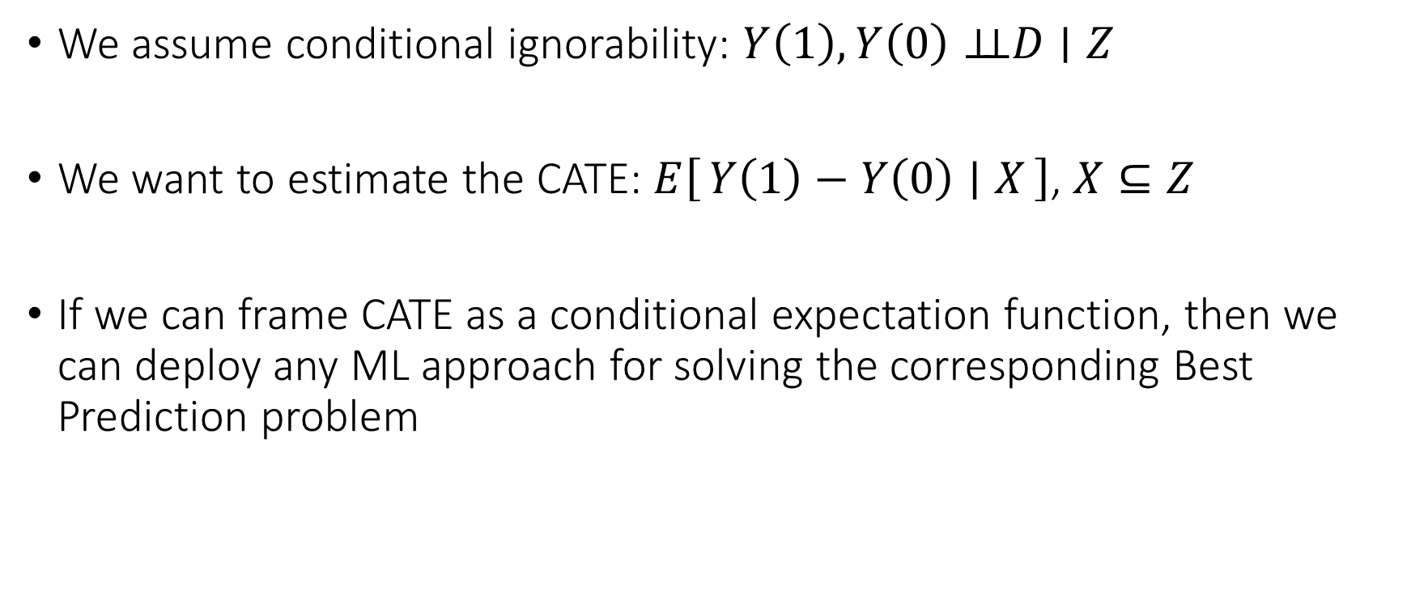
Meta-Learning Idea
We assume conditional ignorability: $Y\left(1\right),Y\left(0\right)⊥⊥D∣Z$
We want to estimate the CATE: $E\left[Y\left(1\right)−Y\left(0\right) ∣ X\right]$, $X⊆Z$
If we can frame CATE as a conditional expectation function, then we can deploy any ML approach for solving the corresponding Best Prediction problem

Slide 41
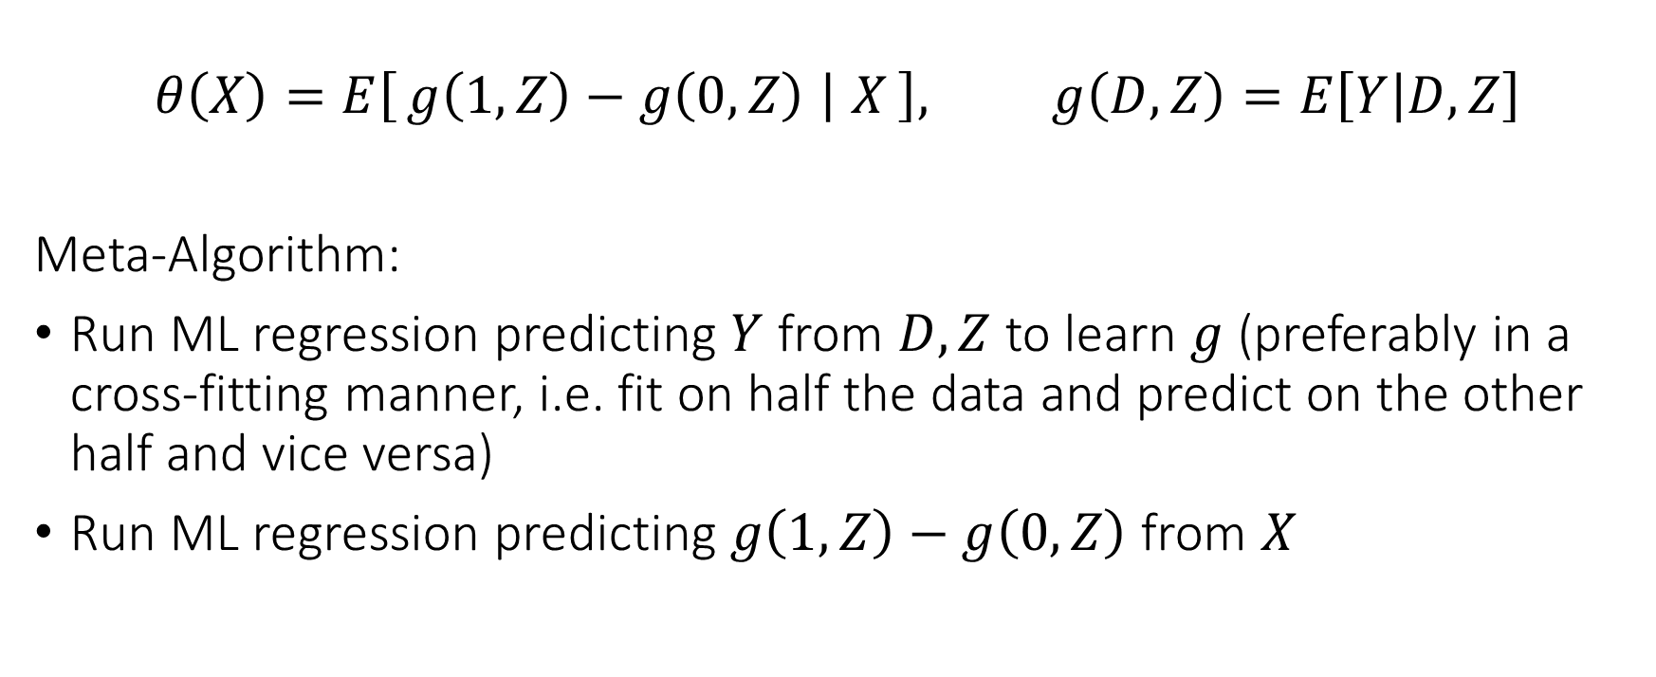
Single Learner (S-Learner)
$$θ\left(X\right)=E\left[g\left(1, Z\right)−g\left(0, Z\right) ∣ X\right], g\left(D,Z\right)=E\left[Y | D,Z\right]$$
Meta-Algorithm:
Run ML regression predicting $Y$ from $D, Z$ to learn $g$ (preferably in a cross-fitting manner, i.e. fit on half the data and predict on the other half and vice versa)
Run ML regression predicting $g\left(1,Z\right)−g\left(0,Z\right)$ from $X$

Slide 42
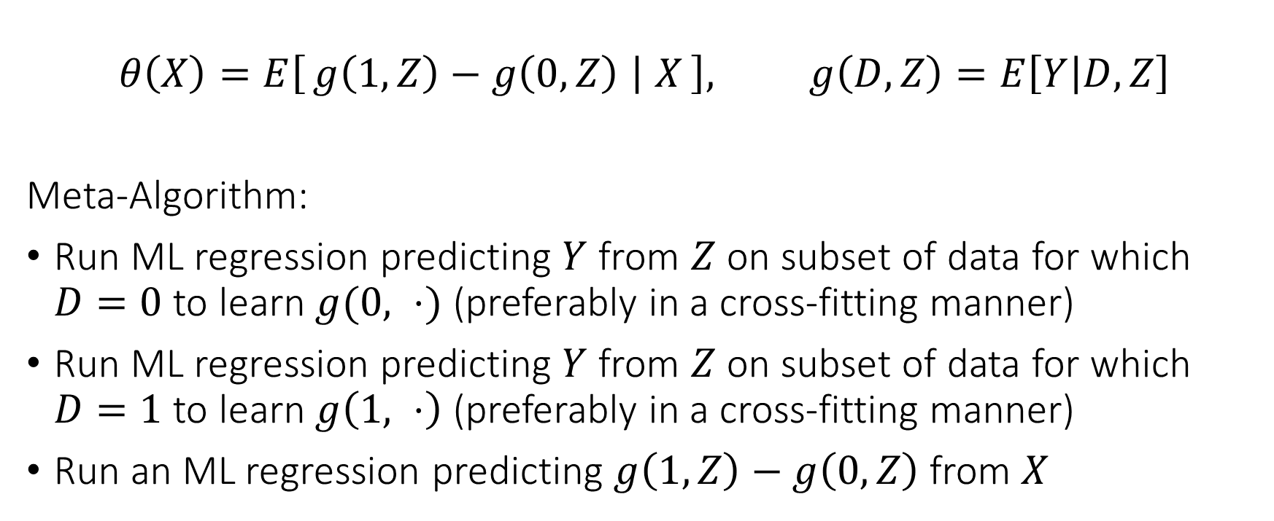
Two Learner (T-Learner)
$$θ\left(X\right)=E\left[g\left(1, Z\right)−g\left(0, Z\right) ∣ X\right], g\left(D,Z\right)=E\left[Y | D,Z\right]$$
Meta-Algorithm:
Run ML regression predicting $Y$ from $Z$ on subset of data for which $D=0$ to learn $g(0, ⋅)$ (preferably in a cross-fitting manner)
Run ML regression predicting $Y$ from $Z$ on subset of data for which $D=1$ to learn $g\left(1, ⋅\right)$ (preferably in a cross-fitting manner)
Run an ML regression predicting $g\left(1, Z\right)−g\left(0,Z\right)$ from $X$

Slide 43
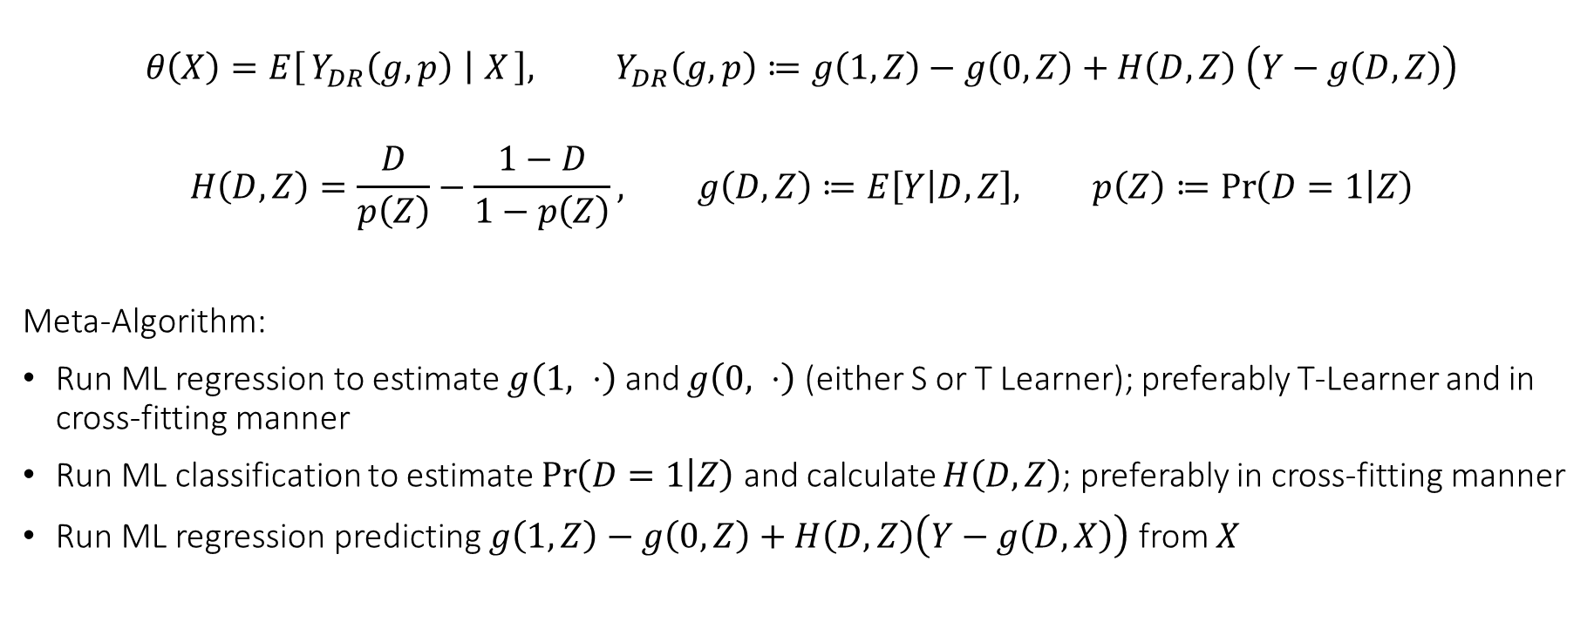
Doubly Robust Learner (DR-Learner)
$$θ\left(X\right)=E\left[Y_{DR}\left(g,p\right) ∣ X\right], Y_{DR}\left(g,p\right)≔g\left(1, Z\right)−g\left(0, Z\right)+H\left(D,Z\right) \left(Y−g\left(D,Z\right)\right)$$
$$H\left(D,Z\right)=\frac{D}{p\left(Z\right)}−\frac{1−D}{1−p\left(Z\right)}, g\left(D,Z\right)≔E\left[Y | D,Z\right], p\left(Z\right)≔\operatorname{Pr}\left(D=1 | Z\right)$$
Meta-Algorithm:
Run ML regression to estimate $g\left(1, ⋅\right)$ and $g\left(0, ⋅\right)$ (either S or T Learner); preferably T-Learner and in cross-fitting manner
Run ML classification to estimate $\operatorname{Pr}\left(D=1 | Z\right)$ and calculate $H\left(D, Z\right)$; preferably in cross-fitting manner
Run ML regression predicting $g\left(1, Z\right)−g\left(0, Z\right)+H\left(D,Z\right)\left(Y−g\left(D,X\right)\right)$ from $X$

Slide 44
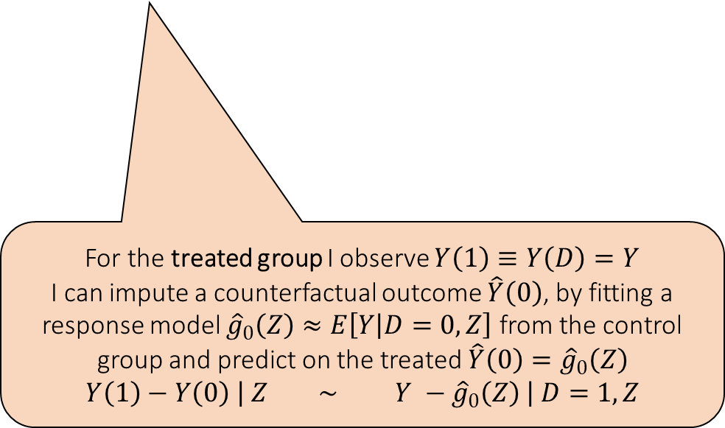
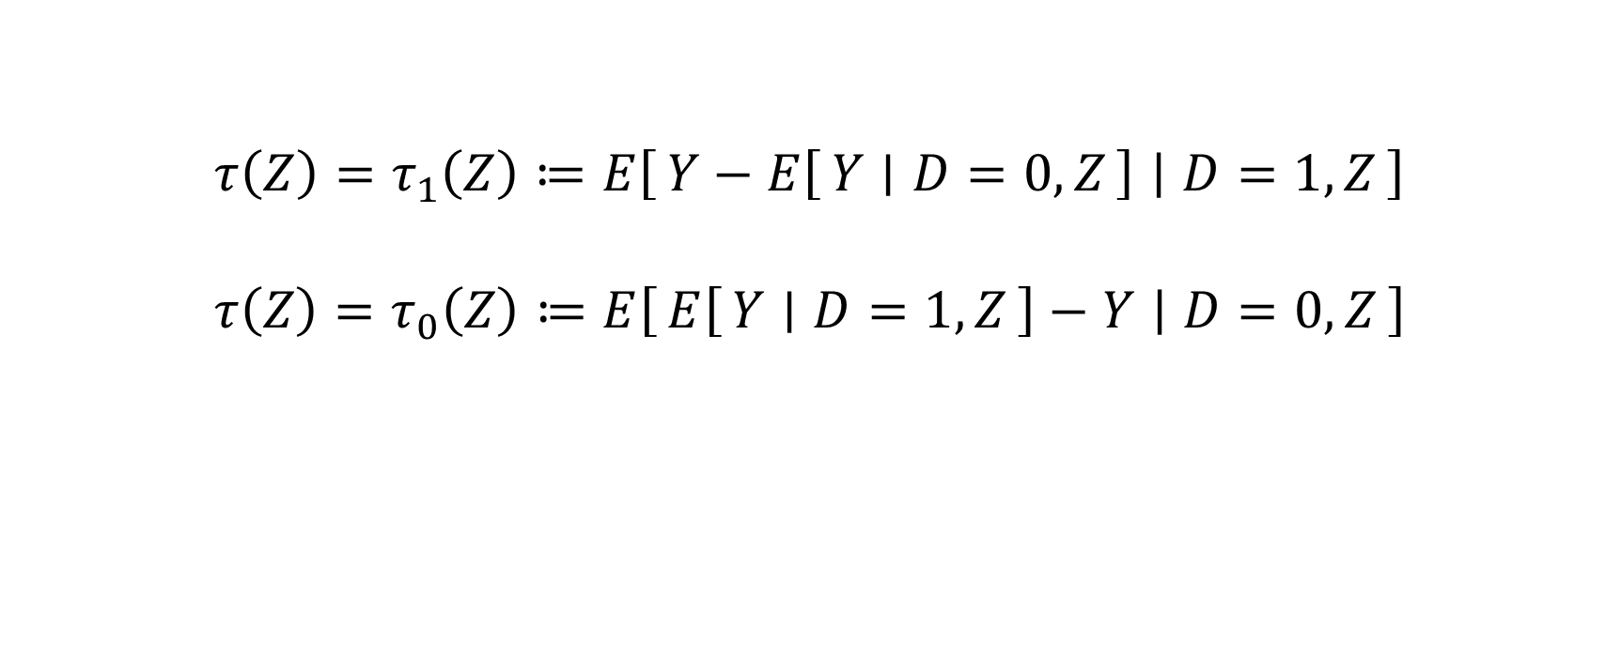
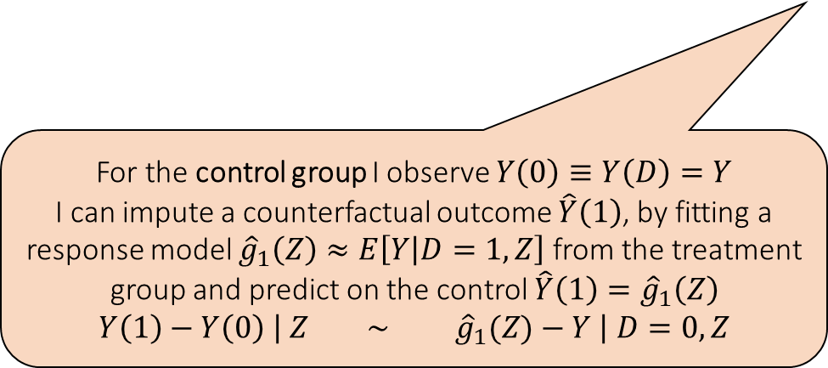
Cross Learner (X-Learner)
$$τ\left(Z\right)=τ_{1}\left(Z\right)≔E\left[Y−E\left[Y ∣ D=0,Z\right] ∣ D=1, Z\right]$$
$$τ\left(Z\right)=τ_{0}\left(Z\right)≔E\left[E\left[Y ∣ D=1,Z\right]−Y ∣ D=0, Z\right]$$
For the control group I observe $Y\left(0\right)≡Y\left(D\right)=Y$
I can impute a counterfactual outcome $\hat{Y}\left(1\right)$, by fitting a response model ${\hat{g}}_{1}\left(Z\right)≈E\left[Y | D=1,Z\right]$ from the treatment group and predict on the control $\hat{Y}\left(1\right)={\hat{g}}_{1}\left(Z\right)$
$$Y\left(1\right)−Y\left(0\right) \left| Z ∼ {\hat{g}}_{1}(Z)−Y \right| D=0, Z$$
For the treated group I observe $Y\left(1\right)≡Y\left(D\right)=Y$
I can impute a counterfactual outcome $\hat{Y}\left(0\right)$, by fitting a response model ${\hat{g}}_{0}\left(Z\right)≈E\left[Y | D=0,Z\right]$ from the control group and predict on the treated $\hat{Y}\left(0\right)={\hat{g}}_{0}\left(Z\right)$
$$Y\left(1\right)−Y\left(0\right) \left| Z ∼ Y −{\hat{g}}_{0}\left(Z\right) \right| D=1, Z$$

Slide 45
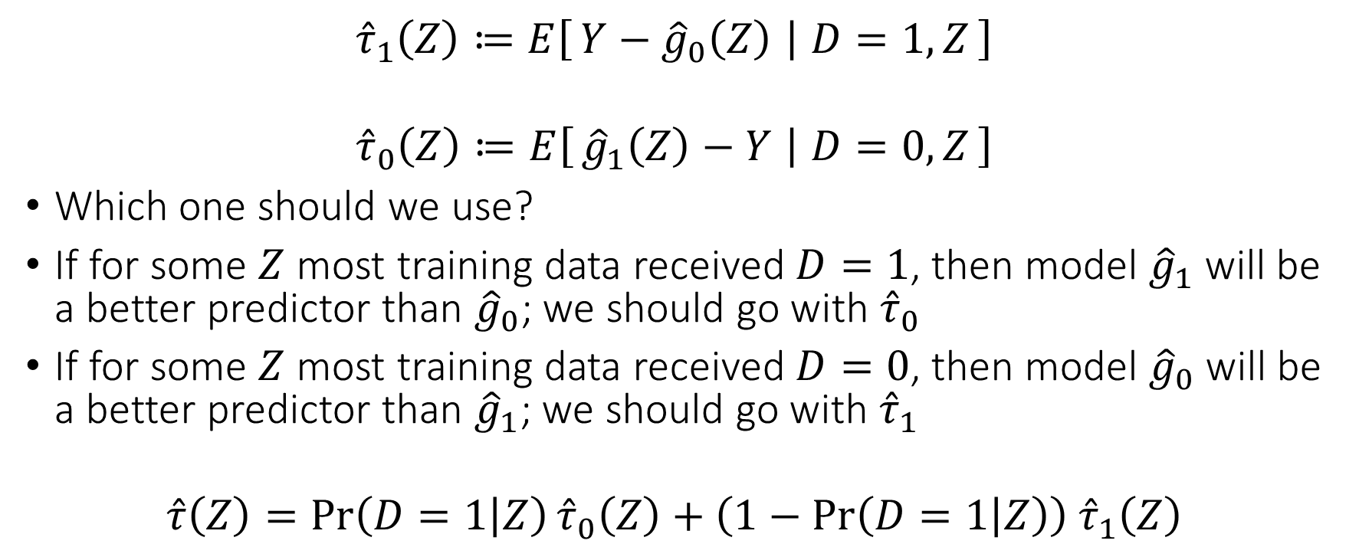
Cross Learner (X-Learner)
$${\hat{τ}}_{1}\left(Z\right)≔E\left[Y−{\hat{g}}_{0}\left(Z\right) ∣ D=1, Z\right]$$
$${\hat{τ}}_{0}\left(Z\right)≔E\left[{\hat{g}}_{1}\left(Z\right)−Y ∣ D=0, Z\right]$$
Which one should we use?
If for some $Z$ most training data received $D=1$, then model ${\hat{g}}_{1}$ will be a better predictor than ${\hat{g}}_{0}$; we should go with ${\hat{τ}}_{0}$
If for some $Z$ most training data received $D=0$, then model ${\hat{g}}_{0}$ will be a better predictor than ${\hat{g}}_{1}$; we should go with ${\hat{τ}}_{1}$
$$\hat{τ}\left(Z\right)=\operatorname{Pr}\left(D=1 | Z\right){\hat{τ}}_{0}\left(Z\right)+\left(1−\operatorname{Pr}\left(D=1 | Z\right)\right) {\hat{τ}}_{1}\left(Z\right)$$

Slide 46
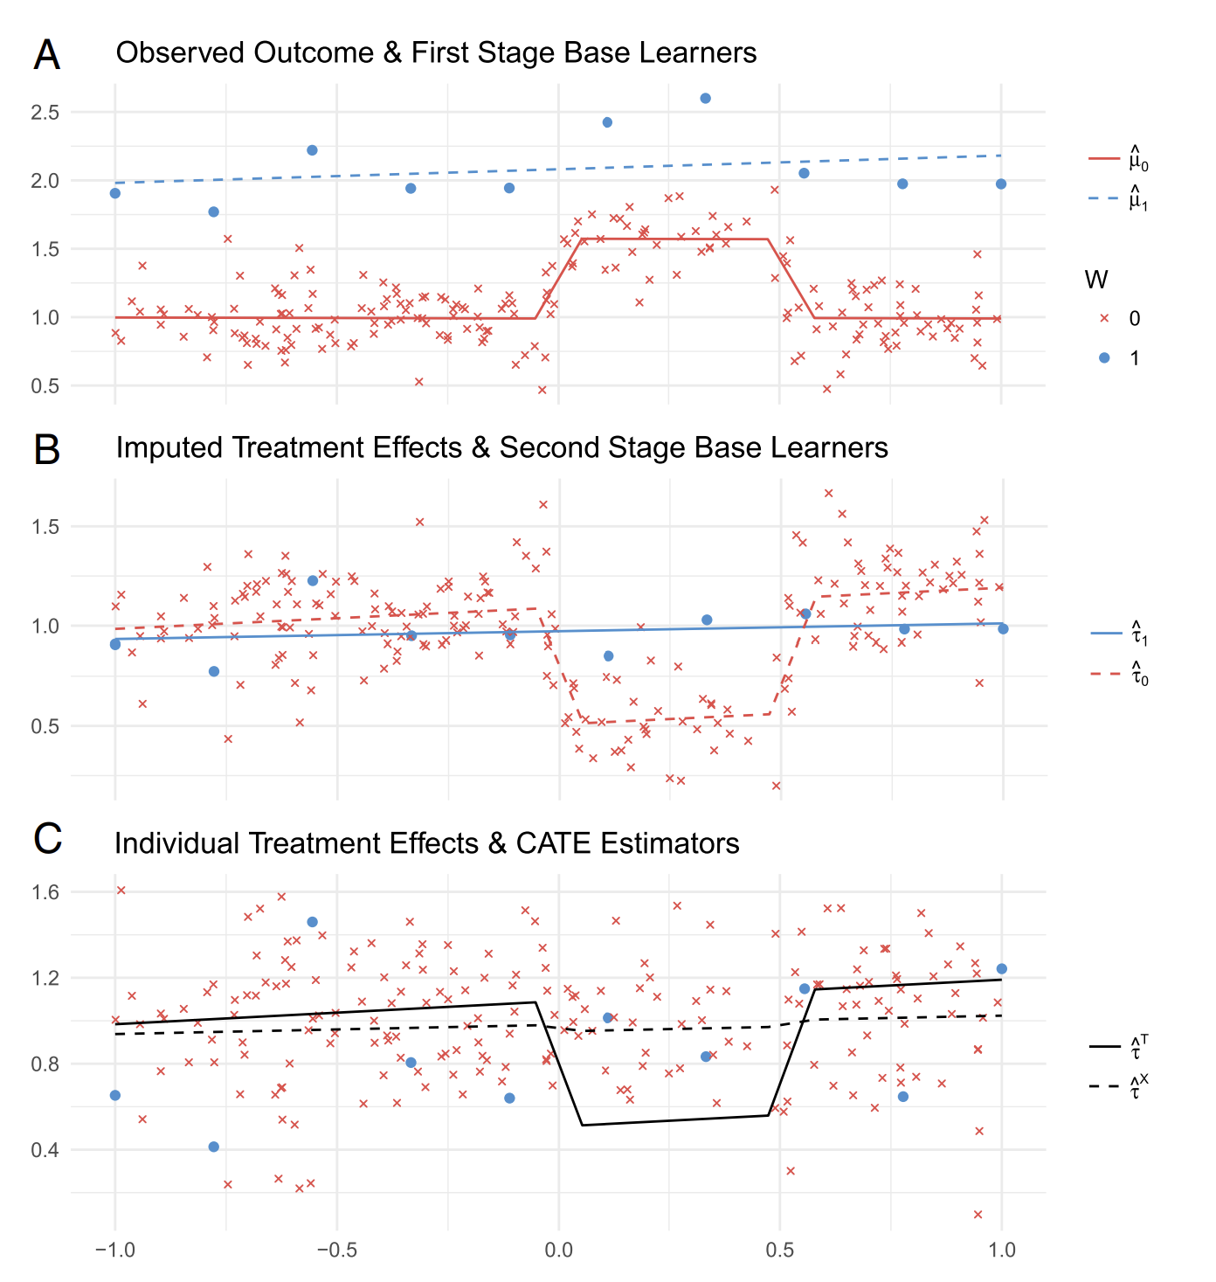
X-Learner Kunzel et al, 2019

Slide 47
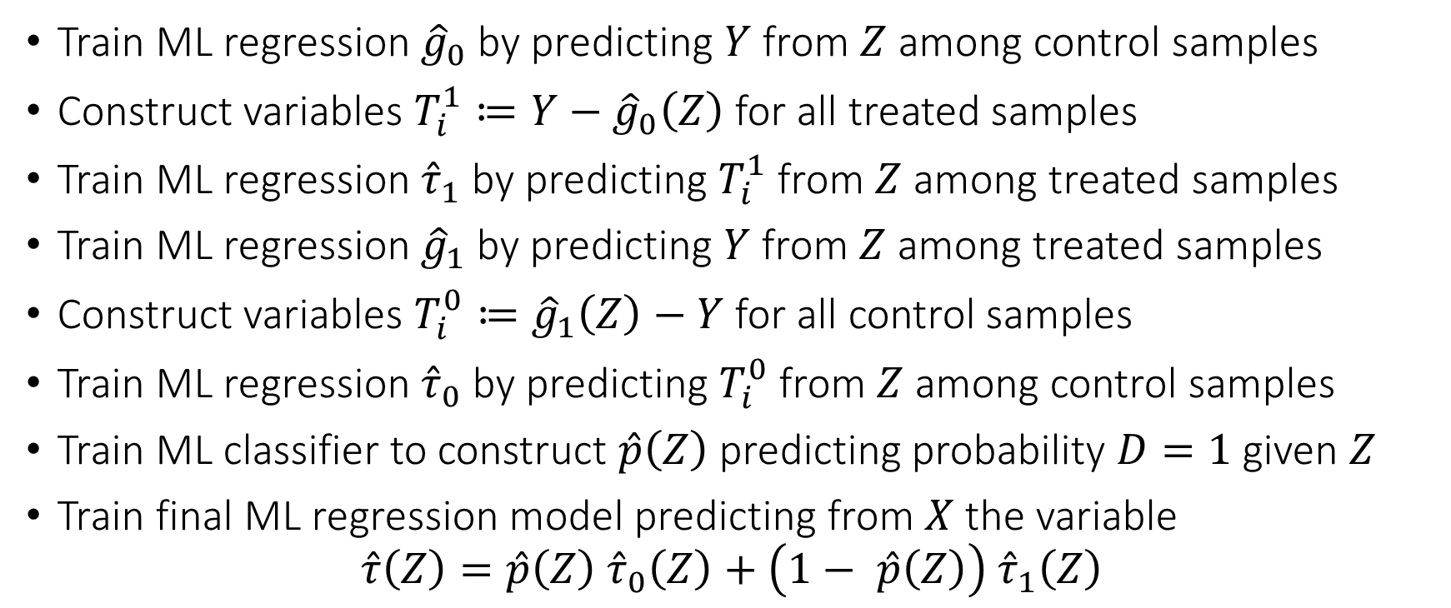
Cross Learner (X-Learner) Meta Algorithm
Train ML regression ${\hat{g}}_{0}$ by predicting $Y$ from $Z$ among control samples
Construct variables $T_{i}^{1}≔Y−{\hat{g}}_{0}\left(Z\right)$ for all treated samples
Train ML regression ${\hat{τ}}_{1}$ by predicting $T_{i}^{1}$ from $Z$ among treated samples
Train ML regression ${\hat{g}}_{1}$ by predicting $Y$ from $Z$ among treated samples
Construct variables $T_{i}^{0}≔{\hat{g}}_{1}\left(Z\right)−Y$ for all control samples
Train ML regression ${\hat{τ}}_{0}$ by predicting $T_{i}^{0}$ from $Z$ among control samples
Train ML classifier to construct $\hat{p}\left(Z\right)$ predicting probability $D=1$ given $Z$
Train final ML regression model predicting from $X$ the variable
$$\hat{τ}\left(Z\right)=\hat{p}\left(Z\right) {\hat{τ}}_{0}\left(Z\right)+\left(1− \hat{p}\left(Z\right)\right) {\hat{τ}}_{1}\left(Z\right)$$

Slide 48
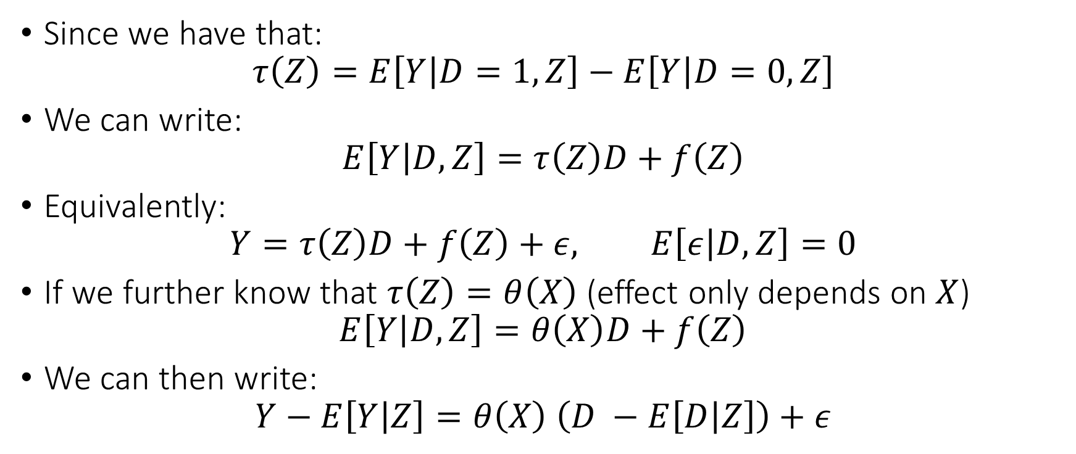
Residual Learner (R-Learner)
Since we have that:
$$τ\left(Z\right)=E\left[Y | D=1,Z\right]−E\left[Y | D=0,Z\right]$$
We can write:
$$E\left[Y | D,Z\right]=τ\left(Z\right)D+f\left(Z\right)$$
Equivalently:
$$Y=τ\left(Z\right)D+f\left(Z\right)+ε, E\left[ε | D,Z\right]=0$$
If we further know that $τ\left(Z\right)=θ\left(X\right)$ (effect only depends on $X$)
$$E\left[Y | D,Z\right]=θ\left(X\right)D+f\left(Z\right)$$
We can then write:
$$Y−E\left[Y | Z\right]=θ\left(X\right) \left(D −E\left[D | Z\right]\right)+ε$$

Slide 49
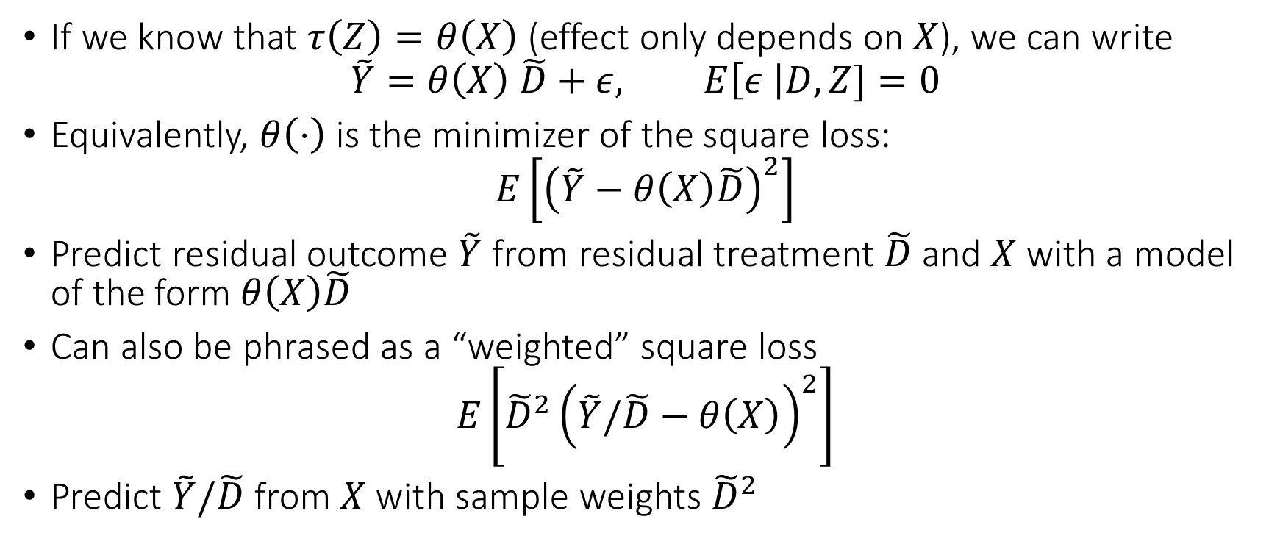
Residual Learner (R-Learner)
If we know that $τ\left(Z\right)=θ\left(X\right)$ (effect only depends on $X$), we can write
$$\tilde{Y}=θ\left(X\right) \tilde{D}+ε, E\left[ε \right|D,Z]=0$$
Equivalently, $θ\left(⋅\right)$ is the minimizer of the square loss:
$$E\left[{\left(\tilde{Y}−θ\left(X\right)\tilde{D}\right)}^{2}\right]$$
Predict residual outcome $\tilde{Y}$ from residual treatment $\tilde{D}$ and $X$ with a model of the form $θ\left(X\right)\tilde{D}$
Can also be phrased as a “weighted” square loss
$$E\left[{\tilde{D}}^{2}{\left(\tilde{Y}/\tilde{D}−θ\left(X\right)\right)}^{2}\right]$$
Predict $\tilde{Y}/\tilde{D}$ from $X$ with sample weights ${\tilde{D}}^{2}$

Slide 50
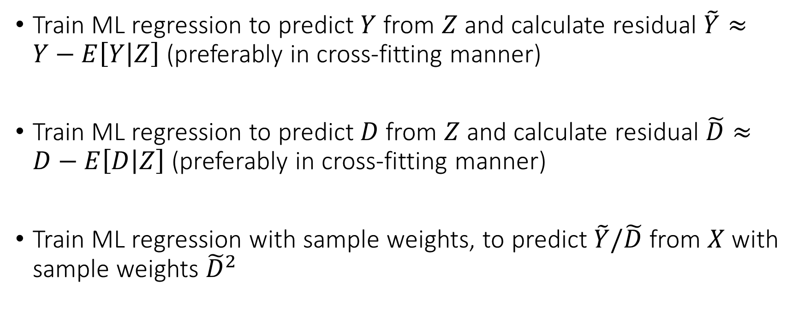
Residual Learner (R-Learner) Meta Algorithm
Train ML regression to predict $Y$ from $Z$ and calculate residual $\tilde{Y}≈Y−E\left[Y | Z\right]$ (preferably in cross-fitting manner)
Train ML regression to predict $D$ from $Z$ and calculate residual $\tilde{D}≈D−E\left[D | Z\right]$ (preferably in cross-fitting manner)
Train ML regression with sample weights, to predict $\tilde{Y}/\tilde{D}$ from $X$ with sample weights ${\tilde{D}}^{2}$

Slide 51
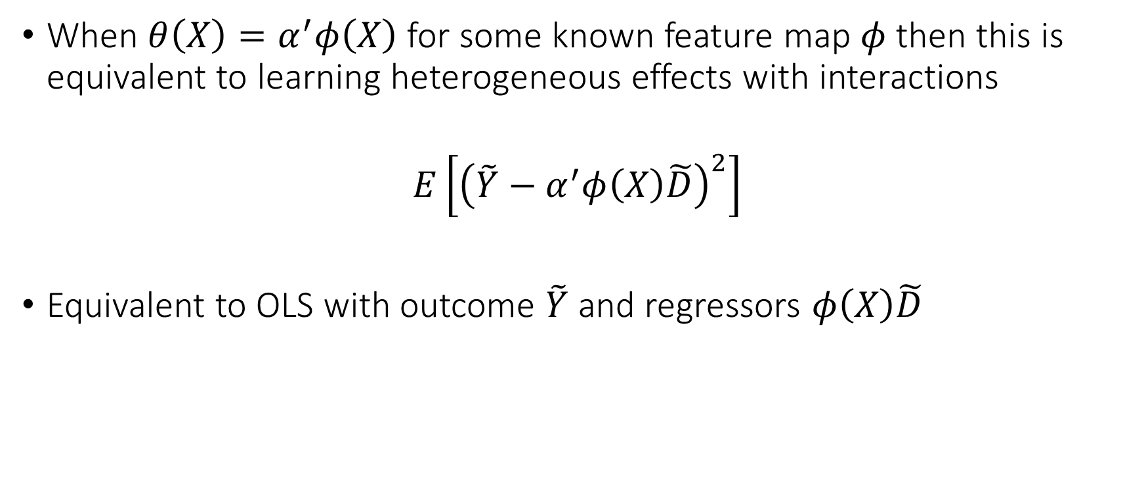
Residual Learner (R-Learner)
When $θ\left(X\right)=α^{′}φ\left(X\right)$ for some known feature map $φ$ then this is equivalent to learning heterogeneous effects with interactions
$$E\left[{\left(\tilde{Y}−α^{′}φ\left(X\right)\tilde{D}\right)}^{2}\right]$$
Equivalent to OLS with outcome $\tilde{Y}$ and regressors $φ\left(X\right)\tilde{D}$

Slide 52
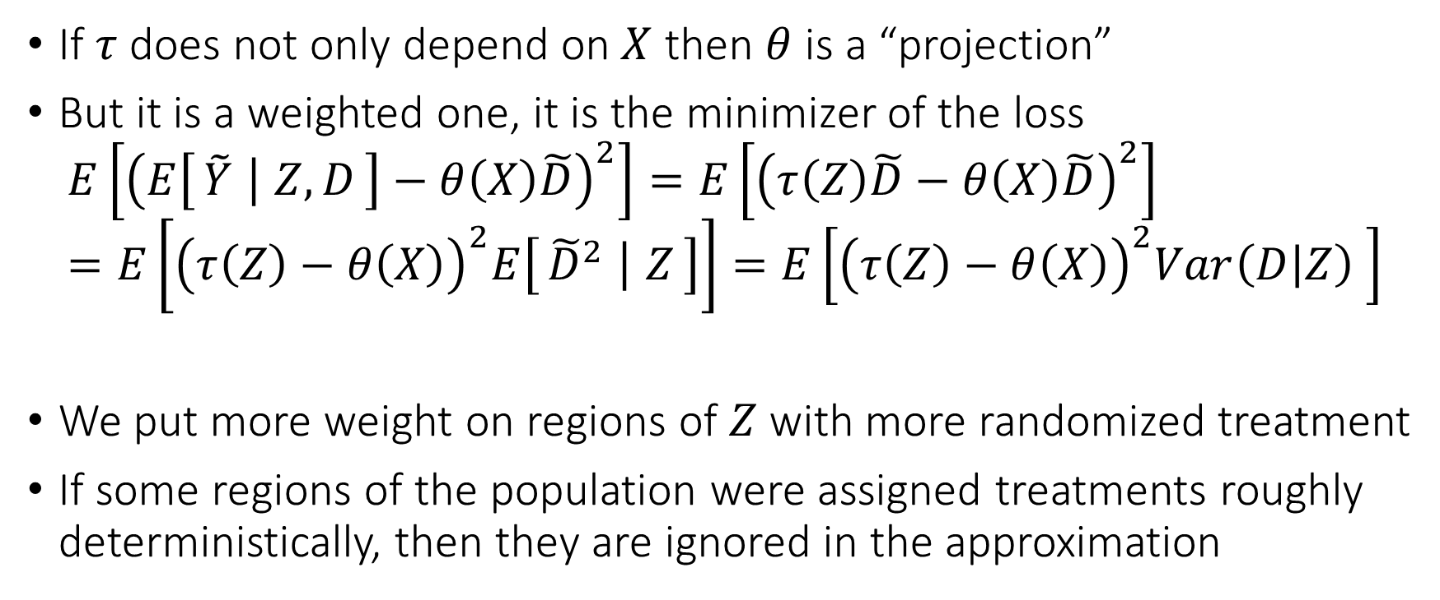
Residual Learner (R-Learner)
If $τ$ does not only depend on $X$ then $θ$ is a “projection”
But it is a weighted one, it is the minimizer of the loss
$$E\left[{\left(E\left[\tilde{Y} ∣ Z,D\right]−θ\left(X\right)\tilde{D}\right)}^{2}\right]=E\left[{\left(τ\left(Z\right)\tilde{D}−θ\left(X\right)\tilde{D}\right)}^{2}\right]=E\left[{\left(τ\left(Z\right)−θ\left(X\right)\right)}^{2}E\left[{\tilde{D}}^{2} ∣ Z\right]\right]=E\left[{\left(τ\left(Z\right)−θ\left(X\right)\right)}^{2}Var\left(D | Z\right) \right]$$
We put more weight on regions of $Z$ with more randomized treatment
If some regions of the population were assigned treatments roughly deterministically, then they are ignored in the approximation

Slide 53
Comparing Meta-Learners
S and T-Learners are typically poor performing as they heavily depend on outcome modelling; among them the T-Learner should be preferred
X-Learner is a better version of S and T as it incorporates propensity knowledge
DR-Learner and R-Learner, both possess “Neyman orthogonality” properties as they carefully combine outcome and treatment assignment modelling
The error of the final cate model is not heavily impacted by the errors in the auxiliary models (Orthogonal Statistical Learning)
DR-Learner estimates un-weighted projection of true CATE on model space, but can be “high-variance” due to inverse propensity
R-Learner estimates variance weighted projection but is much more stable to extreme propensities as it never divides by propensity.

Slide 54
Model Selection and Evaluation

Slide 55

Model Selection within Method
Each of the meta learners is defined based on a loss function
We can use loss function for model selection within each meta-learning approach
For each hyper-parameter evaluate the out-of-sample loss in a cross-validation manner and choose the best hyper-parameter for the meta-learning method
This way we have $M$ CATE models, ${\hat{θ}}_{1}, …,{\hat{θ}}_{M}$ from each meta-learning approach

Slide 56

Model Selection Across Methods
To compare across any CATE learner, we can evaluate based on a “Neyman orthogonal loss”, which is robust to nuisance estimation
R-Loss: for a separate sample, calculate residuals $\tilde{Y},\tilde{D}$ in a cross-fitting manner. For any candidate CATE model $θ$ evaluate
$$L\left(θ\right)≔E\left[{\left(\tilde{Y}−θ\left(X\right)\tilde{D}\right)}^{2}\right]$$
DR-Loss: for a separate sample, calculate regression model $g$ (using T-Learner) and propensity model $p$. For any candidate CATE model $θ$ evaluate
$$L\left(θ\right)≔E\left[{\left(Y_{DR}\left(g,p\right)−θ\left(X\right)\right)}^{2}\right]$$
Given $M$ estimated CATE models ${\hat{θ}}_{1}, …,{\hat{θ}}_{M}$, evaluate the loss out-of-sample and choose the best model
$$m^{∗}≔\underset{m}{argmin}{L\left(θ_{m}\right)}$$

Slide 57

Ensembling and Stacking
We can also use these losses to construct stacked ensembles of a set of CATE models $\left({\hat{θ}}_{1},…,{\hat{θ}}_{M}\right)$:
$${\hat{θ}}_{w}\left(X\right)=\sum_{m=1}^{M}{w_{m}{\hat{θ}}_{m}\left(X\right)}$$
Stacking with R-Loss: (penalized) linear regression predicting $\tilde{Y}$ with regressors $θ_{1}\left(X\right)\tilde{D},…,θ_{M}\left(X\right)\tilde{D}$
$$\min_{w}{E_{n}\left[{\left(\tilde{Y}−\sum_{m=1}^{M}{w_{m}{\hat{θ}}_{m}\left(X\right)}\tilde{D}\right)}^{2}\right]+λPenalty(w)}$$
Stacking with DR-Loss: (penalized) linear regression predicting $Y_{DR}\left(g,p\right)$with regressors $θ_{1}\left(X\right),…,θ_{M}\left(X\right)$
$$\min_{w}{E_{n}\left[{\left(Y_{DR}\left(g,p\right)−\sum_{m=1}^{M}{w_{m}{\hat{θ}}_{m}\left(X\right)}\right)}^{2}\right]+λPenalty(w)}$$

Slide 58

Evaluation via Testing Approaches
If CATE model $\hat{θ}$ was good, then out-of-sample BLP of CATE, when using $\left(1, \hat{θ}\left(X\right)\right)$ as feature map, should assign a lot of weight on $\hat{θ}\left(X\right)$
Run OLS regression predicting$Y_{DR}\left(g,p\right)$ using regressors $\left(1, \hat{θ}\left(X\right)\right)$
$$E\left[{\left(Y_{DR}\left(g,p\right)−β_{0}−β_{1}\hat{θ}\left(X\right)\right)}^{2}\right]$$
Construct confidence intervals and test whether $β_{1}≠0$; then $θ\left(X\right)$ correlates with the true CATE! Ideally $\left(β_{0}=0,β_{1}=1\right)$
The parameter $β_{1}$ is identifying the quantity (in the population limit):
$$β_{1}≔\frac{Cov\left(Y\left(1\right)−Y\left(0\right), \hat{θ}\left(X\right)\right)}{Var\left(\hat{θ}\left(X\right)\right)}$$

Slide 59

Validation via GATEs
For any large enough group $G$, we can calculate out-of-sample group average effects by simply averaging $Y_{DR}\left(g,p\right)$
$$GATE\left(G\right)≔E\left[Y\left(1\right)−Y\left(0\right) | X∈G\right]=E\left[Y_{DR}\left(g,p\right) | X∈G\right]$$
If the CATE model $\hat{θ}$ is accurate, then if we restrict to some group $G$ then the average of $\hat{θ}$ over this group, should match the out-of-sample group average treatment effect
$$E\left[\hat{θ}\left(X\right) | X∈G\right]≈GATE\left(G\right)$$
We can measure such GATE discrepancies out-of-sample

Slide 60

Validation via Calibration
One natural definition of groups is the “percentile groups of the CATE predictions”
For the top 25% of the CATE predictions based on the model $θ$, the mean of model predictions, should match the out-of-sample GATE for that group
Consider a set of quantiles $q_{1},..,q_{K}$ (e.g. 0, 25, 50, 75)
Consider the distribution $D$ of $\hat{θ}(X)$ over the training data $X$
Let $G_{i}$ be the groups defined as $\left\{X:\hat{θ}\left(X\right)∈\left[q_{i} q_{i+1}\right] quantile of D\right\}$
$$τ_{i}≔E\left[\hat{θ}\left(X\right) | X∈G_{i}\right]≈GATE\left(G_{i}\right)≔E\left[Y_{DR}\left(g,p\right) | X∈G_{i}\right]$$
Calibration score:
$$CalScore\left(θ\right)≔\sum_{i}{\operatorname{Pr}\left(G_{i}\right)⋅\left|τ_{i}−GATE\left(G_{i}\right)\right|}$$
Normalized calibration score: $1−\frac{CalScore\left(\hat{θ}\right)}{CalScore\left(constant CATE=E\left[Y_{DR}\left(g,p\right)\right]\right)}$

Slide 61


Testing for Heterogeneity
We can easily construct joint confidence intervals for all the GATEs
GATEs are the coefficients in the BLP of CATE using group one-hot-encoding as features
$$E\left[{\left(Y_{DR}\left(g,p\right)−β^{′}\left(1\left\{X∈G_{1}\right\},…, 1\left\{X∈G_{K}\right\}\right)\right)}^{2}\right]$$
We can use joint confidence intervals for BLP via the DR-Learner
If there was heterogeneity, then we should have that there are GATEs whose confidence intervals are non-overlapping

Slide 62


Stratification Motivated Evaluation
If we were to “prioritize” into treatment based on $\hat{θ}$ with a target to treat around q-percent of population then what would be the GATE of the treated group
Consider distribution $D_{n}$ of $θ(X)$ over training data $X$
We can define the groups:
$$G_{q}≔\left\{X:θ\left(X\right)≥\left(1−q\right)−th quantile of D_{n}\right\}$$
$$τ\left(q\right)=E\left[Y_{DR}\left(g,p\right) ∣ X∈G_{q}\right]−E\left[Y_{DR}\left(g,p\right)\right]$$
Ideally, $τ\left(q\right)$ should be always positive and increasing!
AUTOC $≈$ the area under the curve $τ\left(q\right)$

Slide 63


Stratification Motivated Evaluation
If we were “prioritize” into treatment based on $\hat{θ}$ with a target to treat around q-percent of the population then what would be the policy value we would get over treating $q$ percentage at random
Consider distribution $D_{n}$ of $\hat{θ}(X)$ over the training data $X$
We can define the group:
$$G_{q}≔\left\{X:\hat{θ}\left(X\right)≥\left(1−q\right)−th quantile of D_{n}\right\}$$
$$τ_{Q}\left(q\right)=\operatorname{Pr}\left(X∈G_{q}\right) \left(E\left[Y_{DR}\left(g,p\right) ∣ X∈G_{q}\right]−E\left[Y_{DR}\left(g,p\right)\right]\right)$$
Ideally, $τ_{Q}\left(q\right)$ should be large positive for some values!
QINI $≈$ the area under the curve $τ_{Q}\left(q\right)$

Slide 64
Different Approaches to Relaxing our Goals
Goal 1: Maybe estimate a simpler projection (e.g. analogue of BLP)
Goal 2: Confidence intervals for predictions of this simple projection
Goal 3: Simultaneous confidence bands for predictions of this simple projection
Goal 4: Estimation error rate for the true CATE
Goal 5: Confidence intervals for the prediction of a CATE model
Goal 6: Simultaneous confidence bands for joint predictions of CATE model
Policy Learning
Goal 7: Go after optimal simple treatment policies; give me a policy with value close to the best
Goal 8: Inference on value of candidate treatment policies
Goal 9: Inference on value of optimal policy
Goal 10: Identify responder or heterogeneous sub-groups; policies with statistical significance;
Linear Doubly Robust Learner
Meta-learner approaches: S-Learner, T-Learner, X-Learner, R-Learner, DR-Learner
Neural Network approaches: TARNet, CFR
Random Forest approaches: BART
Modified (honest) ML methods: Generalized Random Forest, Orthogonal Random Forest, Sub-sampled Nearest Neighbor Regression
?? (only classical non-parametric statistic results on confidence bands of non-parametric functions)
Doubly Robust Policy Learning
Doubly Robust Policy Evaluation

Slide 65
Policy Learning

Slide 66

Candidate Policy
What if I have a candidate policy $π$ on who to treat
The average policy effect is of the form:
$$V\left(π\right)=E\left[π\left(X\right) \left(Y\left(1\right)−Y\left(0\right)\right)\right]$$
Under conditional ignorability:
$$V\left(π\right)=E\left[π\left(X\right)\left(E\left[Y | D=1,Z\right]−E\left[Y | D=0,Z\right]\right)\right]$$
We can also measure performance via the doubly robust outcome
$$V\left(π\right)=E\left[π\left(X\right) Y_{DR}\left(g,p\right)\right]$$
Also falls in the Neyman orthogonal moment estimation framework
$$E\left[π\left(X\right)Y_{DR}\left(g,p\right)−θ\right]=0$$
We can easily construct confidence intervals

Slide 67

Policy Optimization
We can optimize over a space of policies $Π$ on the samples
$$\hat{V}\left(π\right)=E_{n}\left[π\left(X\right)Y_{DR}\left(\hat{g},\hat{p}\right)\right]$$
Regret:
$$\max_{π∈Π}V\left(π\right)−V\left(\hat{π}\right)$$
Regret not impacted a lot by errors in $\hat{g}$ or $\hat{p}$
Performance as if true $g,p$ (assuming estimation rates of $n^{−\frac{1}{4}}$)
Maximizing $V\left(π\right)$ can be viewed as sample-weighted classification, with labels $sign\left(Y_{DR}\left(g,p\right)\right)$ and sample weights $\left|Y_{DR}\left(g,p\right)\right|$
Any classification method can be deployed

